Slide 1
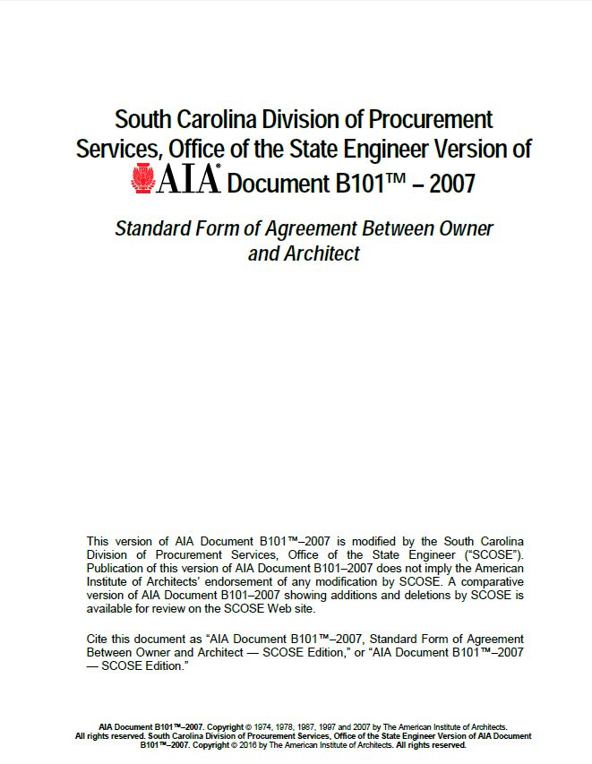
Things you may or may not know about the B101.

Slide 2
Architects Basic Services
Schematic Design Phase
Design Development Phase
Construction Documents Phase
Bidding or Negotiation Phase
Construction Phase
Additional Services
Owner’s Responsibilities
Termination or Suspension
Compensation
Insurance Coverages

Slide 3
Architects Basic Services
What makes up the Basic Services?

Slide 4
Scope of Architects Basic Services
What makes up the Basic Services?
Stage 1 Services Schematic Design
Stage 2 Services DD – Final Completion
Architectural, Civil, Structural, Mechanical, Plumbing, Fire Protection & Electrical
Schematic Design Phase
Design Development Phase
Construction Documents Phase
Bidding or Negotiation Phase
Construction Phase
Evaluation of the Work
Certificates for Payment
Submittals
Changes in the Work
Project Completion

Slide 5
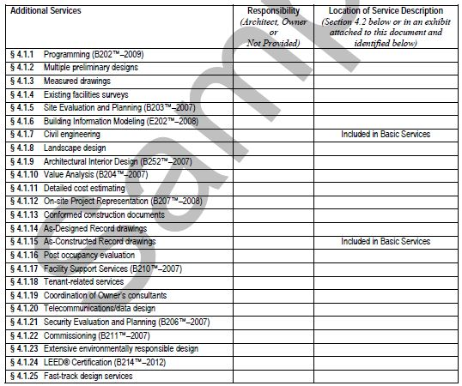
Additional Services
What is not included in the Basic Services And is provided as additional services?

Slide 6
Architects Basic Services
Schematic Design Phase
Design Development Phase
Construction Documents Phase
Bidding or Negotiation Phase
Construction Phase
Additional Services
Owner’s Responsibilities
Termination or Suspension
Compensation
Insurance Coverages

Slide 7
Schematic Design Phase Services
What makes up the Schematic Design Phase Services?

Slide 8
Schematic Design Phase Services
What makes up the Schematic Design Phase Services?
Site plan
Preliminary building plans
Basic Code Review
Sections & elevations
3d rendering
Preliminary selection of building systems
Preliminary selection of construction materials
Incorporation of environmentally responsible design approaches
Estimate of the Cost of Work
OSE table top review

Slide 9
Architects Basic Services
Schematic Design Phase
Design Development Phase
Construction Documents Phase
Bidding or Negotiation Phase
Construction Phase
Additional Services
Owner’s Responsibilities
Termination or Suspension
Compensation
Insurance Coverages

Slide 10
Design Development Phase Services
What makes up the Design Development Phase Services?

Slide 11
Design Development Phase Services
What makes up the Design Development Phase Services?
Developed Schematic Design drawings
Diagrammatic layouts of Building Systems
Structural
Mechanical
Plumbing
Electrical
Outline Specifications for major materials and systems
Estimate of Cost of Work
Submit to owner for review and approval

Slide 12
Architects Basic Services
Schematic Design Phase
Design Development Phase
Construction Documents Phase
Bidding or Negotiation Phase
Construction Phase
Additional Services
Owner’s Responsibilities
Termination or Suspension
Compensation
Insurance Coverages

Slide 13
Construction Documents Phase Services
What makes up the Construction Documents Phase Services?

Slide 14
Construction Documents Phase Services
What makes up the Construction Documents Phase Services?
Drawings and Specifications setting forth the details and requirements for the construction of the work with a quality for the contractor to create shop drawings, Product data and other similar submittals
Maximum Practicable Competition must be maintained listing at least 3 manufacturers
Ultimate preparation of the bidding documents
Estimate of the cost of work
Submission to the Owner and OSE for review and approval

Slide 15
Architects Basic Services
Schematic Design Phase
Design Development Phase
Construction Documents Phase
Bidding or Negotiation Phase
Construction Phase
Additional Services
Owner’s Responsibilities
Termination or Suspension
Compensation
Insurance Coverages

Slide 16
Bidding or Negotiation Phase Services
What makes up the Bidding or Negotiation Phase Services?

Slide 17
Bidding or Negotiation Phase Services
What makes up the Bidding or Negotiation Phase Services?
All final comments from the Owner and OSE have been incorporated into the drawings
Final estimates have been approved
Proposed Contract Documents
Obtain Competitive bids
Confirm responsiveness of bids or proposals
Determine the successful bid or proposal
Award and prepare contracts for construction
Price exceeds owners budget by less than 10%
Price exceeds owners budget by more than 10%

Slide 18
Architects Basic Services
Schematic Design Phase
Design Development Phase
Construction Documents Phase
Bidding or Negotiation Phase
Construction Phase
Additional Services
Owner’s Responsibilities
Termination or Suspension
Compensation
Insurance Coverages

Slide 19
Construction Phase Services
What makes up the Construction Phase Services?

Slide 20
Construction Phase Services
What makes up the Construction Phase Services?
The Architect provides administration of the contract between the Owner & the Contractor as set forth in the A201 General Conditions from signing of the contract to 21 days after final certificate of payment
Evaluations of the Work
Appropriate site visits to determine in general that the work is being installed in accordance with the Contract Documents
Certificates for Payment to Contractor
Work has progressed to the point indicated and the quality of the work is in accordance with the contract documents

Slide 21
Construction Phase Services
What makes up the Construction Phase Services?
Submittals
Shall be reviewed with a reasonable promptness. How many Days?
Changes in the Work
Architect may authorize Minor changes in the work that do not affect cost and time
Change orders
Construction Change directives
Project Completion When do warranties start?
Substantial Completion
Final Completion
10 months after Substantial Completion with no compensation perform building walk through and write a report

Slide 22
Architects Basic Services
Schematic Design Phase
Design Development Phase
Construction Documents Phase
Bidding or Negotiation Phase
Construction Phase
Additional Services
Owner’s Responsibilities
Termination or Suspension
Compensation
Insurance Coverages

Slide 23
Owner’s Responsibilities
What are some of the Owner’s Responsibilities?

Slide 24
Owner’s Responsibilities
What are some of the Owner’s Responsibilities?
Program, schedule, space relationships, special equipment and site requirements
Budget
Surveys
Geotechnical services
Testing and inspections

Slide 25
Architects Basic Services
Schematic Design Phase
Design Development Phase
Construction Documents Phase
Bidding or Negotiation Phase
Construction Phase
Additional Services
Owner’s Responsibilities
Termination or Suspension
Compensation
Insurance Coverages

Slide 26
Termination or Suspension
Who can terminate or Suspended the contract?

Slide 27
Termination or Suspension
Who can terminate or Suspended the contract?
The Architect and the Owner
The Architect may terminate or suspend the contract should the owner fail to make payments in accordance with the contract
Either party can terminate this contract upon not less than 21 days written notice should the other party substantially fail to perform
The owner may terminate for convenience without cause upon not less than 21 days written notice

Slide 28
Architects Basic Services
Schematic Design Phase
Design Development Phase
Construction Documents Phase
Bidding or Negotiation Phase
Construction Phase
Additional Services
Owner’s Responsibilities
Termination or Suspension
Compensation
Insurance Coverages

Slide 29
Compensation
What is Compensation for Services usually based on?

Slide 30
Compensation
What is Compensation for Services usually based on?
Stipulated sum
Percentage of the Cost of the Work
What is used for the Cost of the Work?
Bid proposal or most recent estimate of the Cost of the Work
Stage 1 Services Schematic Design
Stage 2 Services DD – Final Completion
Reimbursable Expenses, how much mark up is allowed for architects consultants?
10%

Slide 31
Architects Basic Services
Schematic Design Phase
Design Development Phase
Construction Documents Phase
Bidding or Negotiation Phase
Construction Phase
Additional Services
Owner’s Responsibilities
Termination or Suspension
Compensation
Insurance Coverages

Slide 32
Insurance Coverages
What is the insurance coverage that the Architect must maintain during the term of the agreement?

Slide 33
Insurance Coverages
What is the insurance coverage that the Architect must maintain during the term of the agreement?
Professional Liability Errors & Omissions $1,000,000.00
Worker’s Compensation
$500,000.00
Automobile Liability
$1,000,000.00
Commercial General Liability
$1,000,000.00

Slide 34
Insurance Coverages
How long shall the Architect maintain this insurance coverage?

Slide 35
Insurance Coverages
How long shall the Architect maintain this insurance coverage?
2 years after the date of Substantial Completion

