Slide 1
Third-Party Inspection Services
Utilizing the
Statewide Term Contract (STC) for Building Inspection Services
Notes:
This presentation will touch on what are believed to be some of the high points of:
• “what are 3rd-party inspections”,
• “why do we have 3rd-party inspections”,
• “how to use the resources available to you as a State Agency”,
• “Agency expectations, assumptions, and understanding of the business of 3rd-party inspections”,
• “how Vendor Firms should be establishing a relationship with the Agency”,
• “sneak-peak into the thought process and approach that should be taken towards estimating”,
• “contract forms required for procurement”,
• “moving from contract to project commencement”, and
• “real world example(s) of how QA inspections help combat in-the-field/ on-site project document deviations”
Hope you find this presentation both informative and enlightening!

Slide 2
Caleb Pozsik
Member of the American Council of Engineering Companies (ACEC) of South Carolina
Employed by KCI Technologies, Inc.

Slide 3
3rd-Party Inspections? …What
Independent and Impartial inspection services provided by a Qualified Company
Independent
Solicited & procured by the Agency
Impartial
Unbiased, fair, safeguard the interests of the Agency
Qualified
Certified, licensed, relevant experience
Notes:
Third-Party Inspections WHAT!!??
3rd-Party Inspections provide INDEPENDENT, IMPARTIAL, & QUALIFIED Quality ASSURANCE
Independence: Allows the selected FIRM to maintain an adequate/ appropriate level of separation between Client, General Contractor, Sub-Contractor(s), & Design Professional. “Fox guarding the Hen House”
Impartial: Unbiased stance/ viewpoint of Project. Provides safeguards to protect the interests of the Agency (State of South Carolina). Ultimately resulting in the protection of budgeted funds & the Tax-payer.
Qualified: Certification and Licensures follow the individual inspector. Governing bodies provide certification for each type of construction activity/ task.

Slide 4
3rd-Party Inspections? …Why
International Code Council (ICC) Code Library
Chapter One (1)
Building
Mechanical
Electrical
Plumbing
Fuel Gas
Fire
Notes:
ICC Document Library are a published set of reference documents which allow interested & respective parties (such as General Contractors, Sub-Contractors, Design Professionals, & Compliance Professionals) to effectively unify each group/ party. This “unification” in effect is the quintessential; “reading the same sheet of music”/ “rowing the same boat”
Code Compliance is a MINIMUM set of standards for any construction, alteration, renovation, retrofit, etc. – simply stated: “the “least” safe a structure/ alteration/ renovation/ etc. can be constructed or amended and be habitable/ occupiable”
When you hear Design Professionals/ GCs/ 3rd-Party Inspection Firms refer to CHAPTER ONE, they are referring to the first chapter of each reference manual which establishes the general requirements, limits, applicability, description of use, scope, administration, intent, interpretation privileges, provisions, and enforcement of code and jurisdictional authority.
Again, these are Quality Assurance Inspections, verifying the selected Contractor has completed installations/ construction in accordance with applicable Project Documents, such as Plans & Specifications, Code Compliance, Jurisdictional Requirements, and/or applicable Governing Body requirements. These Inspections will also provide reassurance that general quality and workmanship conform with industry standard(s). These inspections MUST be completed and documented prior to the issuance of a Certificate of Occupancy.

Slide 5
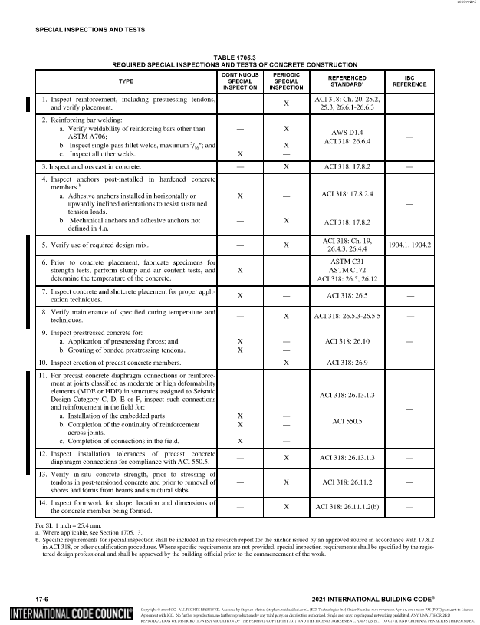
3rd-Party Inspections? …Why
International Code Council (ICC) Chapter Seventeen (17) of the International Building Code (IBC)
Structural Steel
Ie: Welding, Bolting, Fabrication
Reinforced Concrete
Ie: Pre & Post-stressed/ tensioned
Ie: Reinforcing Steel (Rebar)
Structural Masonry
Ie: Concrete Masonry Unit(s) (CMU)
Soils
Spray-applied Fireproofing
Etc.
Notes:
Chapter Seventeen (17) refers to the respective chapter located within the International Building Code (for Commercial Structures).
This Chapter identifies and provides a variety of procedures and criteria for the testing of materials, inspection of assemblies, and observations and/or visual inspections of structural components/ members that MUST be provided and documented by qualified individuals. These reports ensure both Project Document Compliance and suitability of installed materials, ensuring that, once constructed, comply with the minimum structural, fire-resistance, and approved design requirements. Referred to/ known as “Special Inspections”; the provisions of this Chapter govern and are submitted to the Building Official/ Authority Having Jurisdiction (AHJ) upon completion/ near-completion of a Project, but prior to the issuance of a Certificate of Occupancy.
**IMPORTANT TO NOTE**: Overlaps between Chapter 1 & Chapter 17 DO EXIST! And it is important to note that while footing/ foundation inspections seem simple and appear that they could possibly be completed at the same time/ consolidated within 1 or 2 visits, the Chapter 1 footing/ foundation inspection is a critical inspection that not all Special Inspectors are “technically” qualified to complete. Explain…

Slide 6
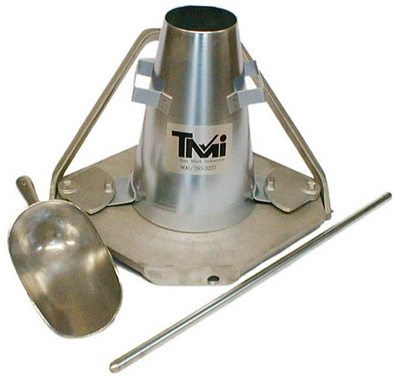
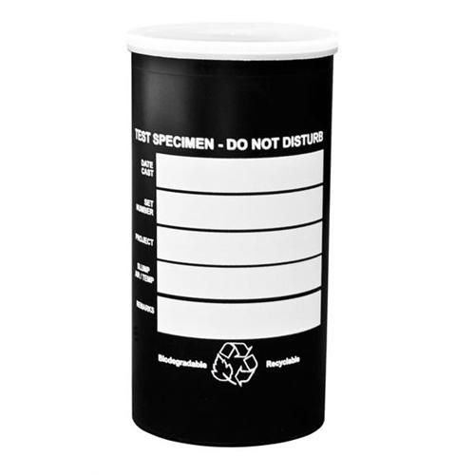
3rd-Party Inspections? …Why
Construction Material(s) Testing (CMT)
Soils/ Earthwork
Proof-rolling, In-situ Soils, Fill Placement, Bearing Verification
Concrete
Sampling, Strength Verification
Masonry Grout
Sampling, Strength Verification
Notes:
Construction Materials Testing & Inspections are the general observation(s), inspection(s), and sampling of “Construction Materials”, such as soils, concrete(s), mortar.
These inspections and/or sampling/ on-site testing offer the ability to VERIFY strength of materials and assure document compliance.

Slide 7
3rd-Party Inspections? …Why
VERIFY and Provide:
Construction Document(s) requirements
Plans & Specifications, Submittal(s), Shop Drawings
Code Compliance
Authority Having Jurisdiction(AHJ) requirements
Governing Body requirements
Quality Assurance (QA)
Notes:
IN SUMMARY

Slide 8
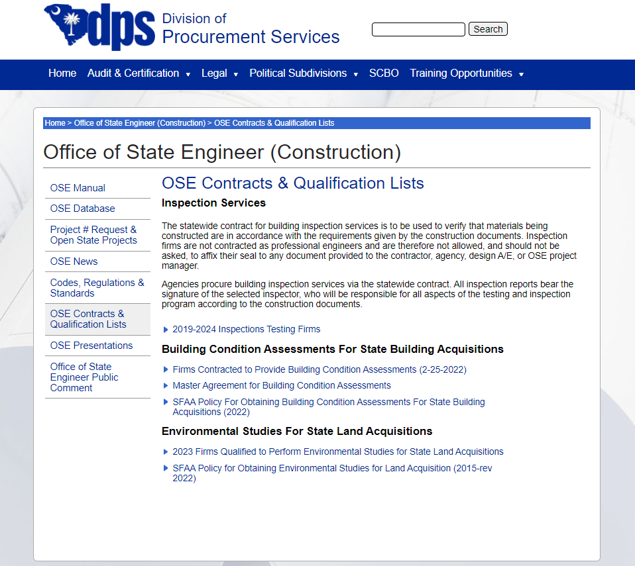
3rd-Party Inspections? …How
STC Building Inspection Services
Office of the State Engineer (OSE) Contracts & Qualification List(s)
“Goods & Service”
Pre-qualified Inspection(s) & Testing Firm(s)
Select the Vendor/ Firm of Choice
Notes:
How many are already familiar with State Contracts and Procurement??
The Statewide Term Contract (STC) for Building Inspection Services is offered to any State Agency or “Agency” which receives State Funding or would like to utilize the Procurement Procedures and Requirements of the State.
Listed as a “Goods & Service”; this allows for the simple “selection” of a vendor VERSUS a “competitive Bid selection”.
The Office of the State Engineer has pre-qualified EACH of the Vendor Firms listed within/ on their website. This allows users of the STC to focus on the inspection needs ONLY.
HOWEVER! Not all Firms at Created Equal!
Consideration should be given to:
Current Workload
Availability & Currency of Staff
Relevant Experience
Specifics of Required/ Requested Inspection(s) and Ability to ACCURATLEY Estimate “Number of Inspections”
RELATIONSHIP

Slide 9
Agency → Firm Selection Understanding the Business
Agencies should anticipate and understand:
Vendor Firms want to establish Relationships with Agencies and Clients alike!
Responsible, Reasonable, Representative, and Realistic Approach
Leverage the established relationship(s) made with the Design Professional or Program Manager/ Construction Manager (If applicable)
Budgeting (Agency):
“Economy of Scale”
0.5% to 1.5% of the total Construction Budget
Smaller Construction Budgets will yield higher inspection costs
Notes:
Agencies should understand the Business of Inspection Firms…
The “intent” of a Reputable Firms IS NOT to estimate the largest budget possible, in hopes that an Agency or Client will just ACCEPT the anticipated cost(s).
Firms that want to establish a strong and lasting relationship with an Agency or Client alike, will/ should provide a RESPONSIBLE, REASONABLE, REPRESENTATIVE, and REALISTIC Estimate that is easy to navigate and understand!
Request the Design Professional to assist in the “anticipation” of what to expect, the items requiring inspection, and in some cases, request the Design Professional to aid in the estimating of number of inspections.
Architects will typically provide “soft costs” as part of their overall publication of Anticipated Project Costs. These “Soft Costs” will typically include “inspections by Owner” considerations.

Slide 10
Agency → Firm Selection Agency Expectations & Assumptions
Agencies should consider/ request:
Vendor Firms with related experience providing inspection services for similar Scope(s) of Work
Relevant Project Experience & Agency References
Capable & “Available”
Estimates which provide a Reasonable and Responsible representation of realistic amounts of inspections that may be required
Avoid “Bidding” by soliciting multiple Firms
mis-representation of realistic number(s) of inspections

Slide 11
Agency & Firm Interaction Inspection Firm Responsibilities & Considerations
Inspection Firms should consider/ request:
Construction Scope & Materials
Construction Timeframe/ Critical Path Method (CPM) Schedule
Selected/ Awarded General Contractor & Sub-Contractors
Experience with similar Scope of Work, Previous Project Experience, Experience with the State of South Carolina – Office of the State Engineer/ Procurement
Appropriate/ Negotiated Amount of “Contingency”
Assumed considerations, such as: Contractor Preparedness & Contractor Quality Control, Contractor & Sub-contractor delays (weather, equipment, materials, labor resources, inevitable delays)
Notes:
Once the Agency has selected a Firm (or Firms) to provide 3rd-Party Inspections, the interaction between the Agency, (Design Professional(s)), and Vendor Firm should begin to take shape, and considerations by the Vendor Firm to establish a Project Approach/ Scope of Work should include, but not necessarily limited to:

Slide 12
Estimating Inspections → Budget Inspection Firm Approach
Estimating Budgets can be VERY subjective.
It is IMPORTANT to understand that projects CAN NOT/ SHOULD NOT be estimated by construction value and/or square-footage alone.
Notes:
Estimating can be VERY Subjective! (Typically) The subjective approach towards any Project is going to be based solely on the cumulation of experiences encountered by that Firm and/or it’s Management’s deployment/ accommodation of providing inspections to that Contractor. These considerations or though-process accommodations/ anticipations SHOULD be communicated with the Agency prior to final selection/ award.
This seemingly minor aspect has an enormous impact on the levelness of the “playing field”.

Slide 13
Estimating Inspections → Budget Inspection Firm Approach - Foundation Example

Slide 14
Estimating Inspections → Budget Inspection Firm Approach - Mechanical Example

Slide 15
Estimating Inspections → Budget Inspection Firm Approach - Plumbing Example

Slide 16
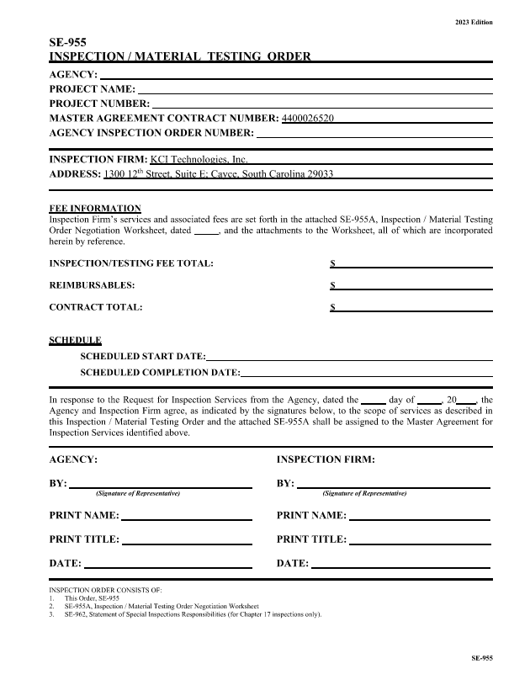
Contract Form(s) SE-955

Slide 17
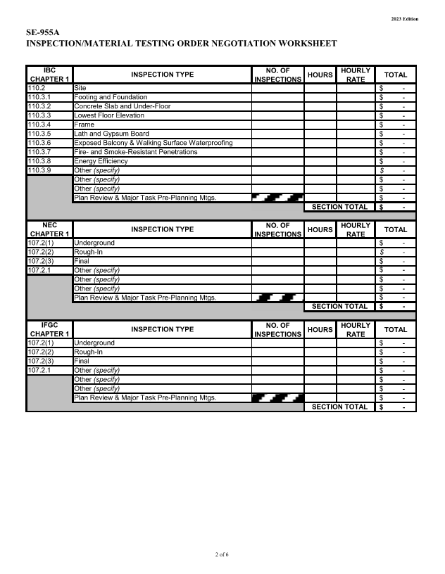
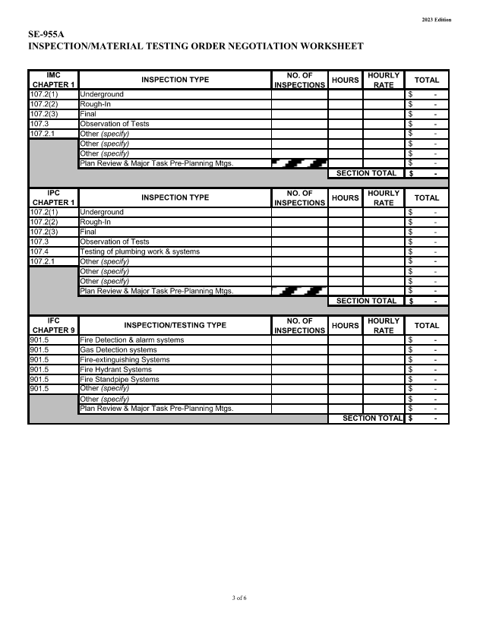
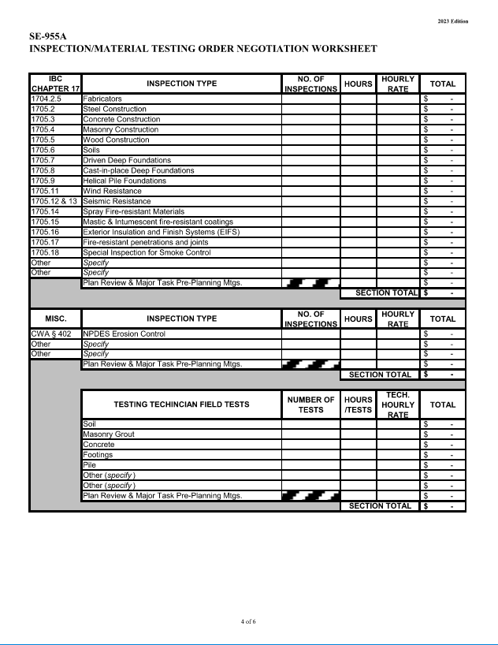
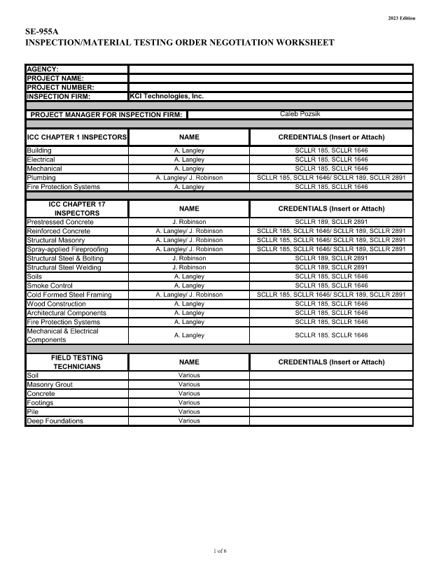
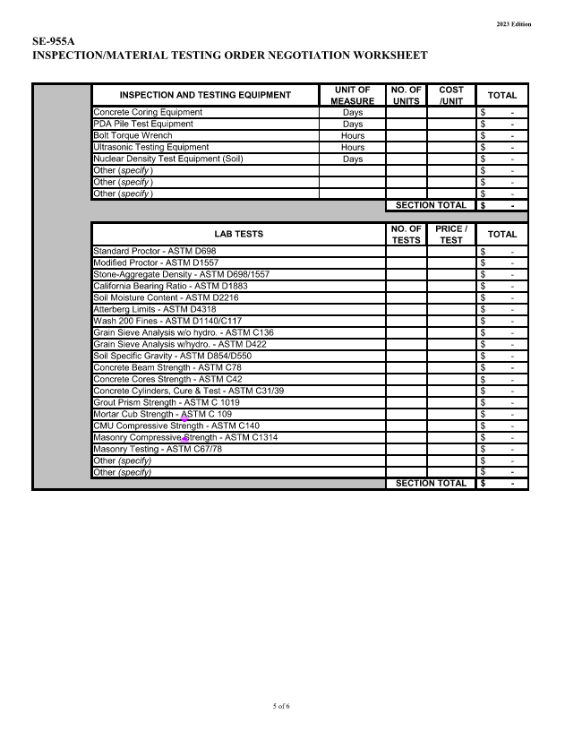
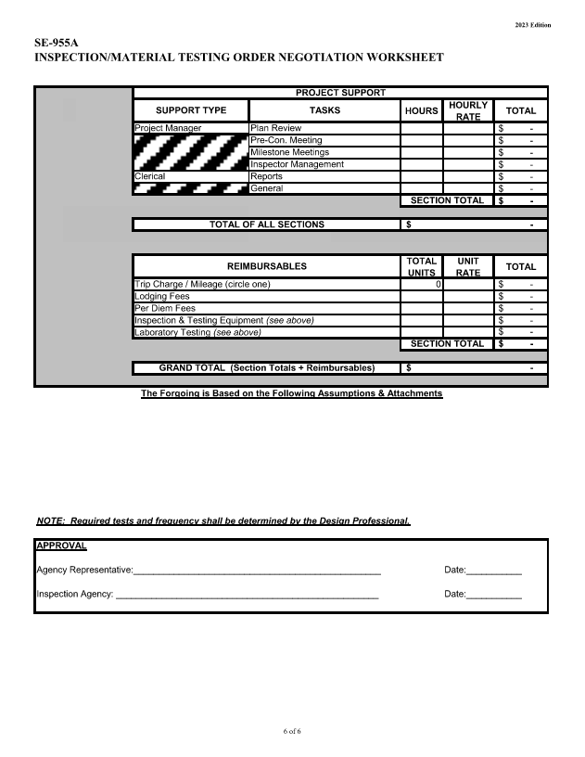
Contract Form(s) SE-955A

Slide 18
Contract to Commencement Pre-Construction Conference
Selected 3rd-Party Inspection Firm should be present
“How to Schedule Inspections” Protocol
Number(s) and Type(s) of Inspection(s) Estimated
Set Expectations, Review Scope of Work, Establish Line of Communication

Slide 19
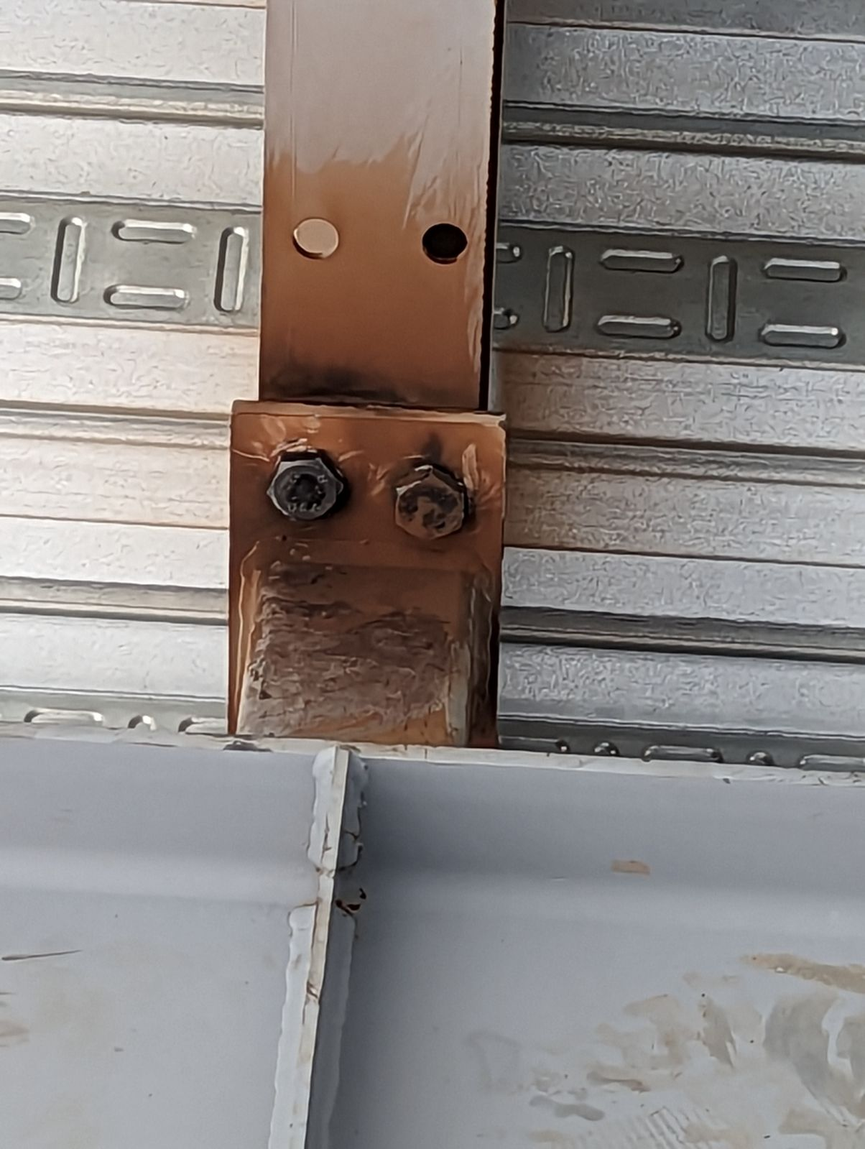
The “Real-World” Plan(s) & Specification Deviations
Notes:
Misaligned Structural Steel Member
Bolted Connection
APPEARS to have been flame cut/ torched to complete the bolted connection.
Flame cut/ torched alternations are NOT an approved method!

Slide 20
The “Real-World” Plan(s) & Specification Deviations
Notes:
Steel Erection
Omitted installation of cross-members

Slide 21
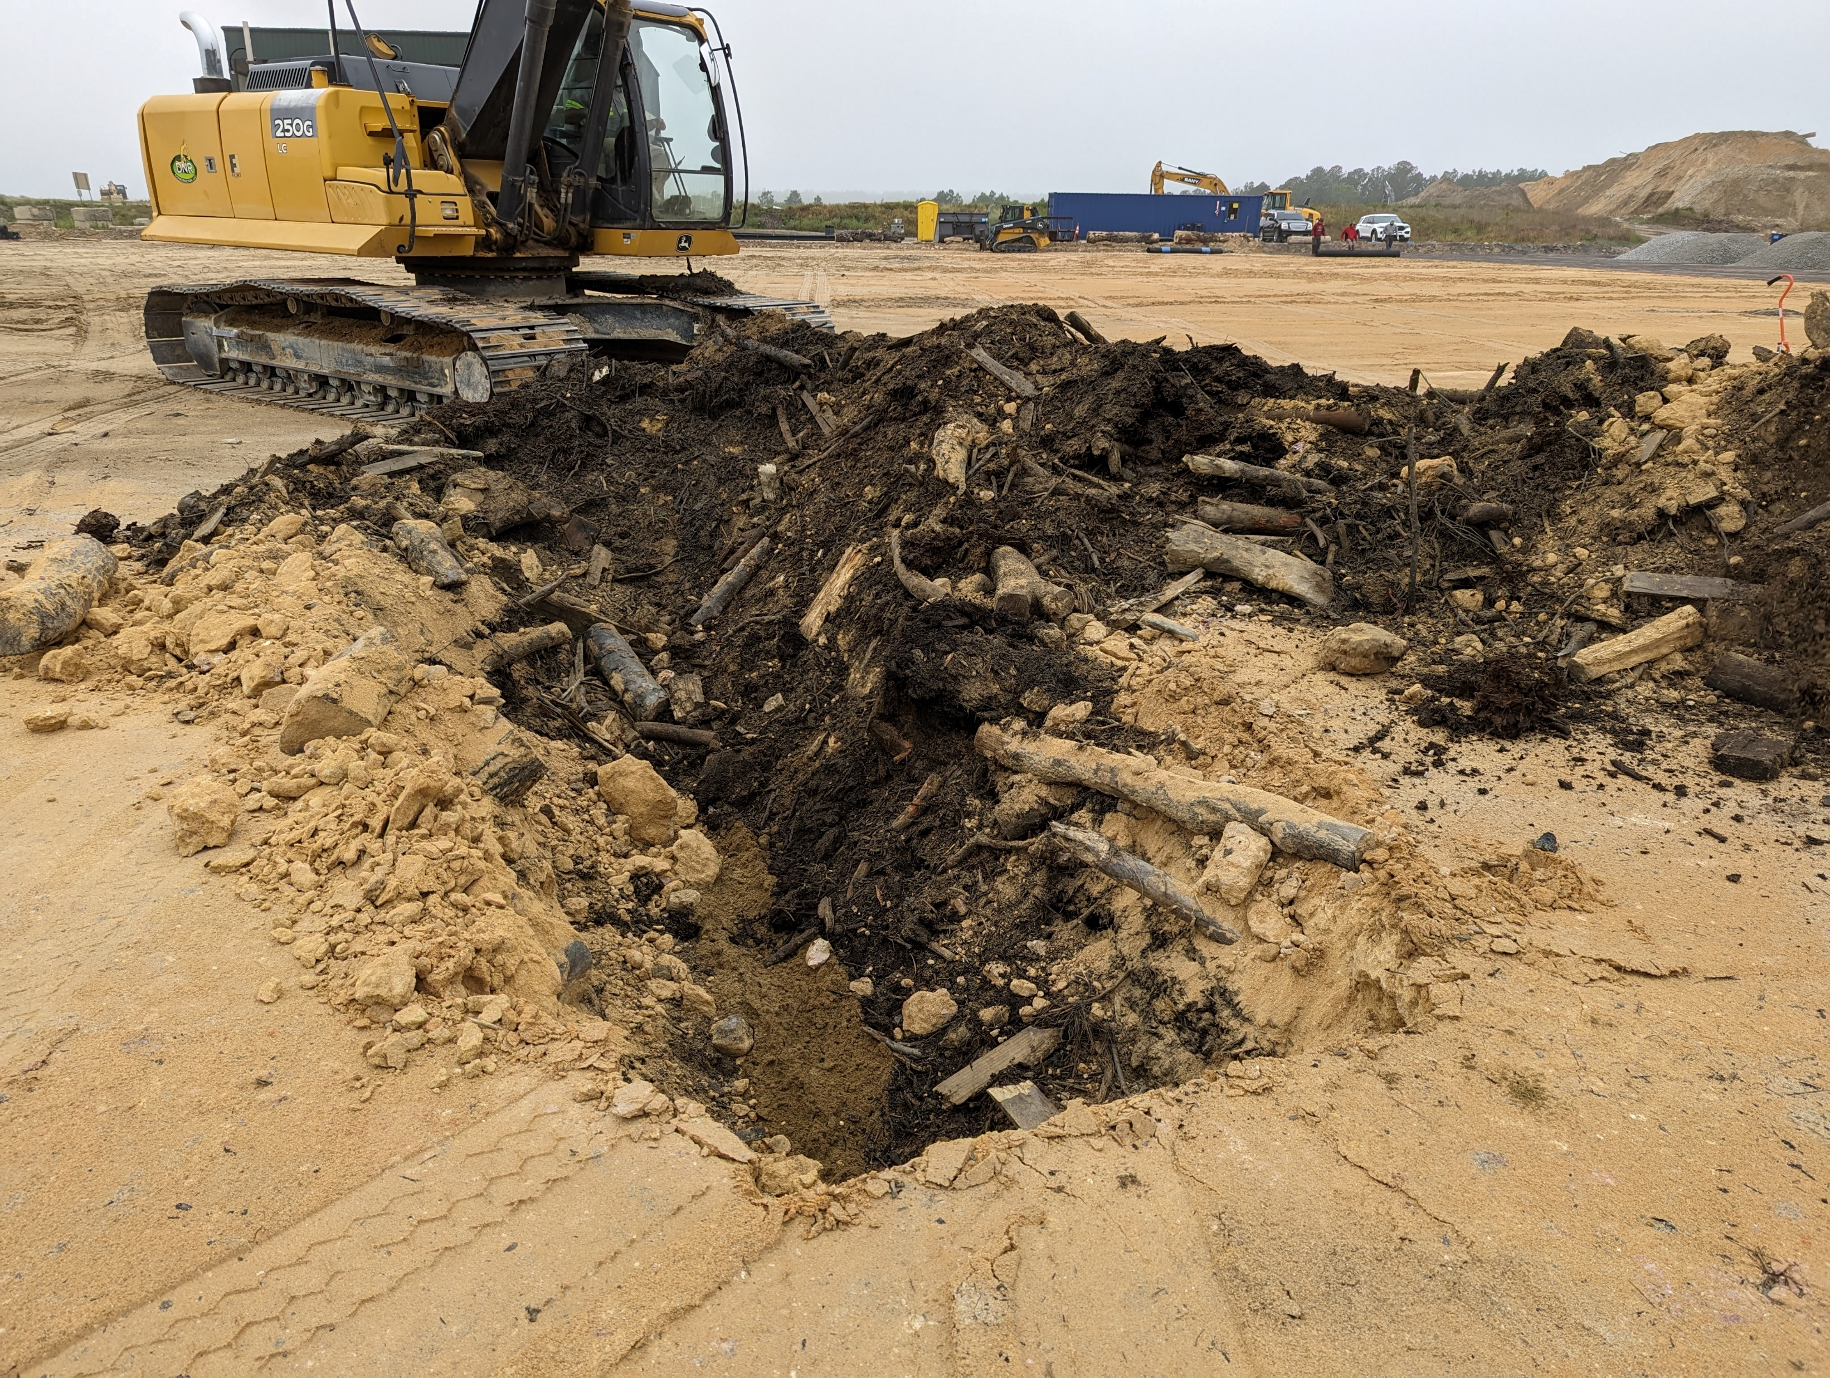
The “Real-World” Plan(s) & Specification Deviations / Encountered Conditions
Notes:
Proofroll Observations which lead to the discovery of buried organic materials under the proposed building foundation

Slide 22
The “Real-World” Plan(s) & Specification Deviations / Encountered Conditions
Typically encounter:
Plan Deviations OR “Assumed” Installation Methods
“Always Done This Way” or “Have Done it this Way for Years”
Specification Deviations/ Lack of Specification Specifics
Submittal or Shop Drawing Omissions/ Deviations
“Approved”; however deviate from the Original Design Intent or Inadvertently Omit Project Requirements
Incorrect Installation
Unforeseen Site Conditions Encountered
Reliant on Disseminated Information without Verification/ Validation

Slide 23
In Summary
Quality Assurance, NOT Quality Control
Unbiased Defender and Protector of the State
Technical Matter Expert(s) of Construction Activities
Project Councilor
Aid & Assist with the Successful Deployment and Completion of Construction Projects
Moral, Ethical, and Fair Mediator/ Project Team Member

Slide 24
Thank You!

