Slide 1
The Koger Amendment
What it Says and What it Means

Slide 2
Dixon Robertson prepared this presentation for the OSE 2021 Facility Directors Conference held October 20-22, 2021. Any opinions expressed in the presentation are his own, and do not reflect an official position of the State Fiscal Accountability Authority.

Slide 3
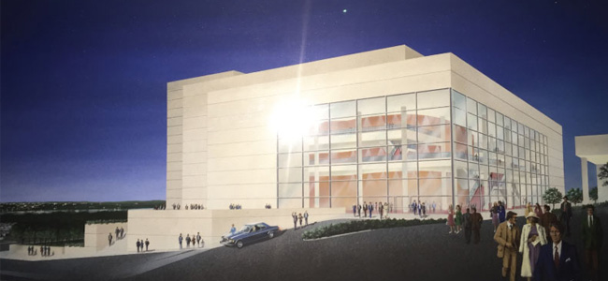

Slide 4
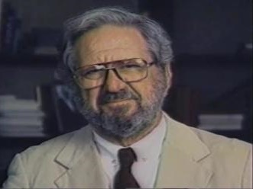
Once upon a time…
Ira McKissick Koger was born December 5, 1912, in Charleston
Graduated College of Charleston and attended USC Law School
Elected to the General Assembly in 1934 at the age of 21 and co-authored the State’s first worker’s compensation law
Served in the US Navy during World War II
Lifelong member of the American Federation of Musicians
Moved to Jacksonville, Florida and made millions developing and operating office parks
Along with his wife Nancy, a prolific and generous patron of the arts

Slide 5
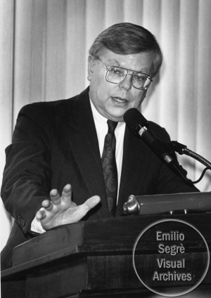
$210,000,000.00

Slide 6
In the late 1970’s the University of South Carolina plans an 800-seat performing arts center. Presently, the Iran and Nancy Koger Foundation pledges five million dollars for what becomes known as the “Ira and Nancy Koger Center for the Arts.” The Kogers’ donation is based on the construction cost estimate for the center.
USC channels the donation through the Carolina Research and Development Foundation, a non-profit corporation operating exclusively for the benefit of the University.
Soon, the governments of Richland County and the City of Columbia express interest in the project. They approach USC and offer to participate if the seating is increased. Plans are revised to include a 2,256-seat auditorium, and estimated construction costs rise to $15 million.
The City and County contribute land and pledge $5.75 million toward construction of the larger center. Combined with the Koger gift this leaves a funding shortfall of nearly five million dollars.
USC continues to seek private donations. CRDF plans to borrow the difference if USC will pay interest on the note. Meantime, USC asks the Commission on Higher Education to approve a lease of the Center from CRDF.
With CHE approval, USC asks the Budget and Control Board to approve the lease. The Board makes no commitment to recommend the lease and directs USC to submit it for approval at some time in the future. According to the Board’s records, no lease is ever presented for its approval.
The General Assembly includes $300,000 as a supplemental appropriation in the 1996 budget act for the Koger Center. In September 1986 USC makes the first lease payment of $802,500 to CRDF. Construction has not begun.
The stage is now set for 1987….

Slide 7
1987

Slide 8
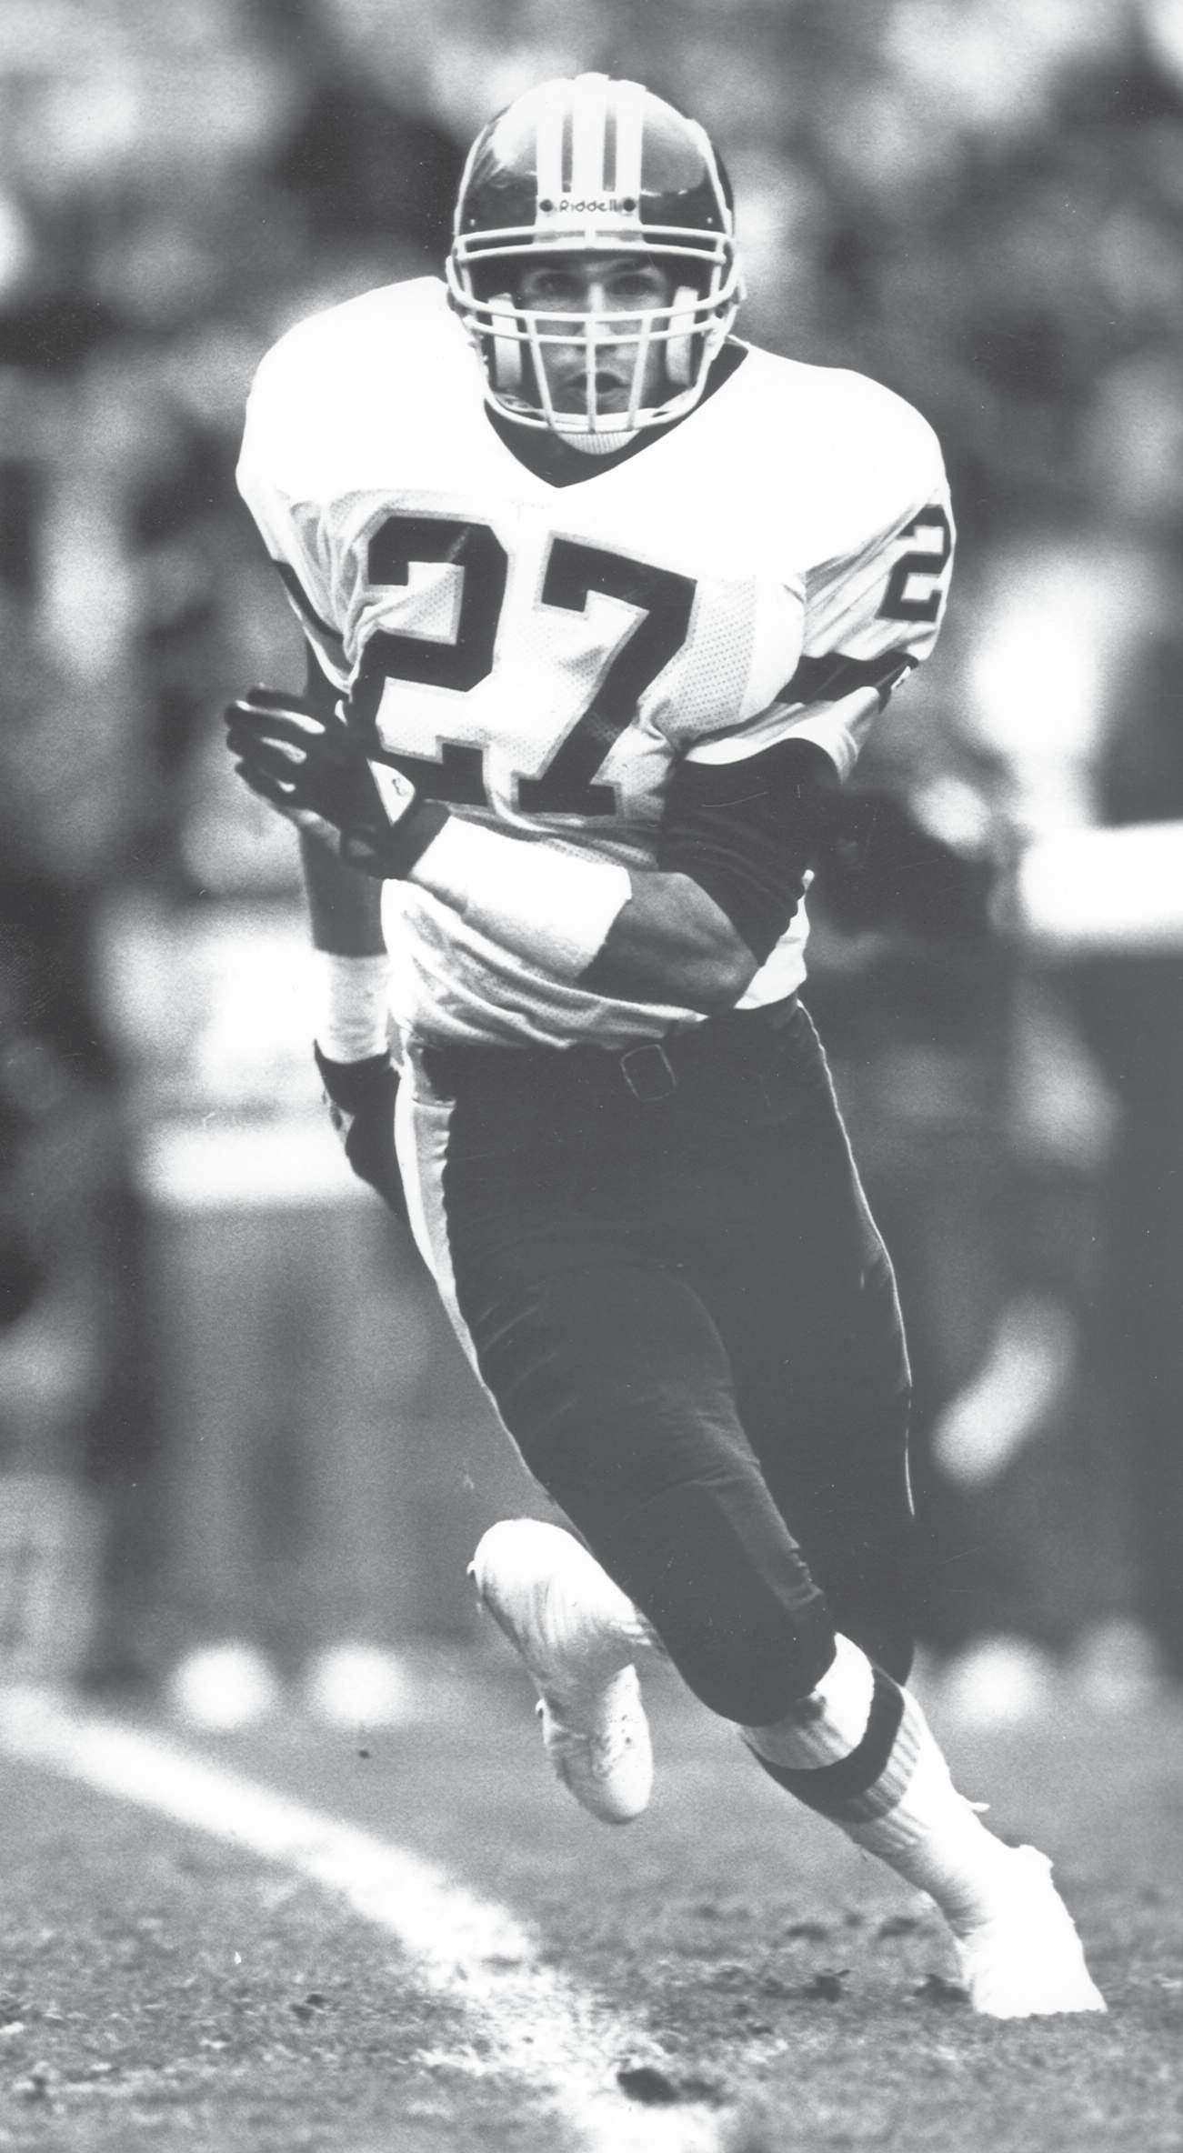
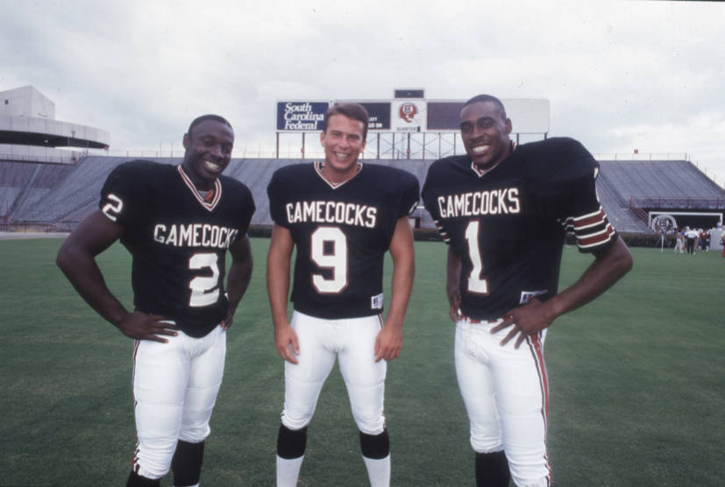

Slide 9
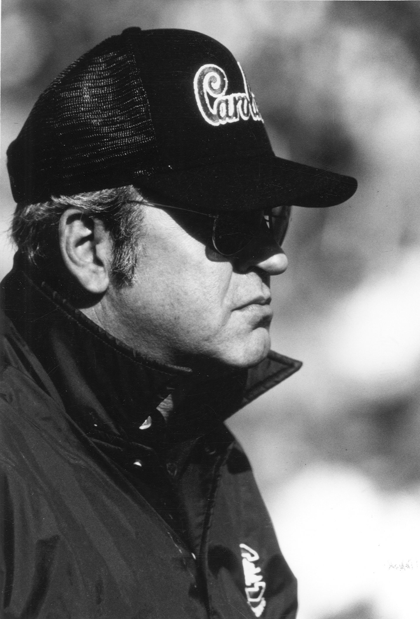
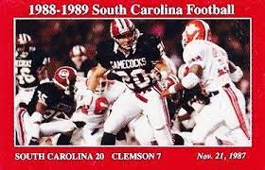
SOUTH CAROLINA 20 CLEMSON 7 Nov. 21, 1987

Slide 11
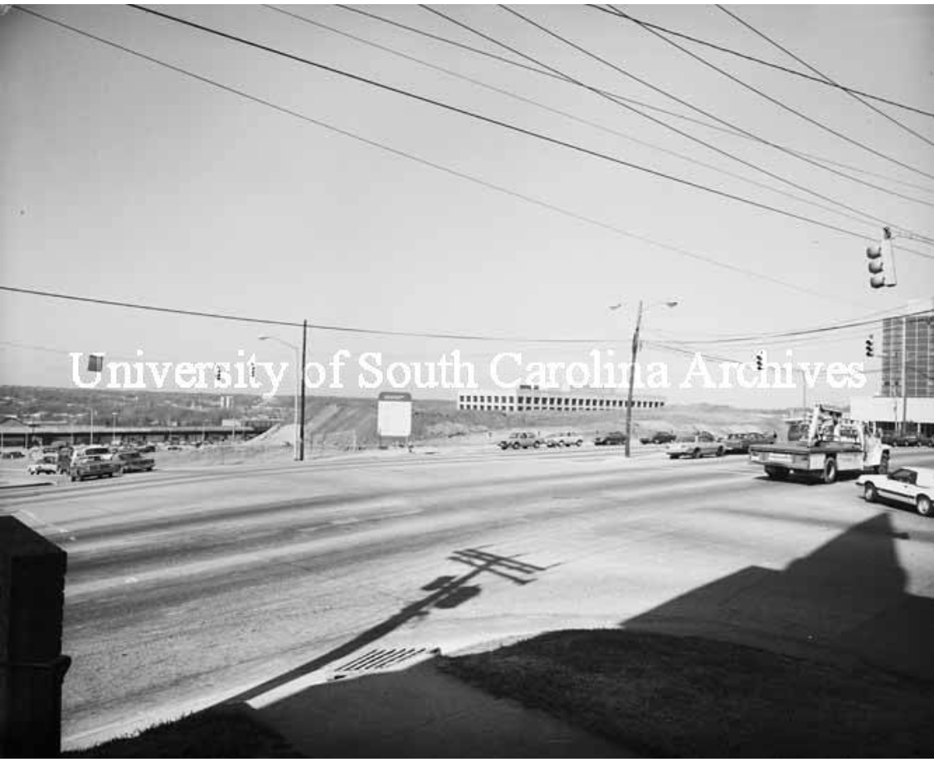
January 1987
CRDF awards $15 million no-bid contract
for the Koger Center.

Slide 12
February 1987
Construction begins.

Slide 13
April 1987
CRDF Executive Director writes a state senator
that USC does not expect any state funds would
be required for Koger Center construction.

Slide 14
April 1987
Then-State Senator Joe Wilson requests the Attorney
General declare that the Consolidated Procurement
Code applies to both CRDF’s contract with M. B. Kahn
and USC’s lease of the Koger Center from CRDF.

Slide 15
May 11, 1987
Attorney General issues his opinion that the CPC
does not apply to either transaction.

Slide 16
June 22, 1987
Koger Amendment, included in Part II of the 1987-88
annual appropriations act, becomes law.

Slide 17
January 1988
USC makes second $802,500 lease payment for
Koger Center to CRDF.

Slide 18
January 1989
USC makes third $802,500 lease payment for
Koger Center to CRDF.

Slide 20
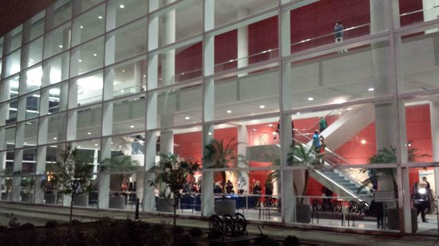
January 14, 1989
Opening night at the Koger Center features the
London Symphony Orchestra.

Slide 22
Application of the Code
This code applies to every procurement or expenditure of funds by this State under contract acting through a governmental body as herein defined irrespective of the source of the funds….
S.C. Code Ann. § 11-35-40(2)
This code applies to every procurement or expenditure of funds by this State under contract acting through a governmental body as herein defined irrespective of the source of the funds….
S.C. Code Ann. § 11-35-40(2)

Slide 23
§ 11-35-310(25): “Procurement” means buying, purchasing, renting, leasing, or otherwise acquiring any supplies, services, information technology, or construction. It also includes all functions that pertain to the obtaining of any supply, service, information technology, or construction, including description of requirements, selection, and solicitation of sources, preparation and award of contracts, and all phases of contract administration.

Slide 24
Application of the Code
This code applies to every procurement or expenditure of funds by this State under contract acting through a governmental body as herein defined irrespective of the source of the funds….
S.C. Code Ann. § 11-35-40(2)

Slide 25
Application of the Code
This code applies to every procurement or expenditure of funds by this State under contract acting through a governmental body as herein defined irrespective of the source of the funds….
S.C. Code Ann. § 11-35-40(2)

Slide 26
§ 11-35-310(8): “Contract” means all types of state agreements, regardless of what they may be called, for the procurement or disposal of supplies, services, information technology, or construction.

Slide 27
Application of the Code
This code applies to every procurement or expenditure of funds by this State under contract acting through a governmental body as herein defined irrespective of the source of the funds….
S.C. Code Ann. § 11-35-40(2)

Slide 28
Koger doesn’t matter
Contracts between the agency and its foundation
Either an acquisition or an expenditure triggers the Code
Acquisition under contract alone is sufficient
“Expenditure” can be indirect
Providing utilities or internet access
Source of funds does not matter
If agency pays, Code applies

Slide 30
What Koger Says
The acquisition of a facility or capital improvement by a foundation or eleemosynary organization on behalf of or for the use of any state agency or institution of higher learning which involves the use of public funds in the acquisition, financing, construction, or current or subsequent leasing of the facility or capital improvement is subject to the provisions of this code in the same manner as a governmental body….
S.C. Code Ann. § 11-35-40(4)
The acquisition of a facility or capital improvement by a foundation or eleemosynary organization on behalf of or for the use of any state agency or institution of higher learning which involves the use of public funds in the acquisition, financing, construction, or current or subsequent leasing of the facility or capital improvement is subject to the provisions of this code in the same manner as a governmental body….
S.C. Code Ann. § 11-35-40(4)

Slide 31
What Koger Says
The acquisition of a facility or capital improvement by a foundation or eleemosynary organization on behalf of or for the use of any state agency or institution of higher learning which involves the use of public funds in the acquisition, financing, construction, or current or subsequent leasing of the facility or capital improvement is subject to the provisions of this code in the same manner as a governmental body….
S.C. Code Ann. § 11-35-40(4)

Slide 32
What Koger Says
The acquisition of a facility or capital improvement by a foundation or eleemosynary organization on behalf of or for the use of any state agency or institution of higher learning which involves the use of public funds in the acquisition, financing, construction, or current or subsequent leasing of the facility or capital improvement is subject to the provisions of this code in the same manner as a governmental body….
S.C. Code Ann. § 11-35-40(4)

Slide 33
What Koger Says
The acquisition of a facility or capital improvement by a foundation or eleemosynary organization on behalf of or for the use of any state agency or institution of higher learning which involves the use of public funds in the acquisition, financing, construction, or current or subsequent leasing of the facility or capital improvement is subject to the provisions of this code in the same manner as a governmental body….
S.C. Code Ann. § 11-35-40(4)

Slide 34
What Koger Says
The acquisition of a facility or capital improvement by a foundation or eleemosynary organization on behalf of or for the use of any state agency or institution of higher learning which involves the use of public funds in the acquisition, financing, construction, or current or subsequent leasing of the facility or capital improvement is subject to the provisions of this code in the same manner as a governmental body….
S.C. Code Ann. § 11-35-40(4)

Slide 35
What Koger Says
The acquisition of a facility or capital improvement by a foundation or eleemosynary organization on behalf of or for the use of any state agency or institution of higher learning which involves the use of public funds in the acquisition, financing, construction, or current or subsequent leasing of the facility or capital improvement is subject to the provisions of this code in the same manner as a governmental body….
S.C. Code Ann. § 11-35-40(4)

Slide 36
§ 11-35-310(27): “Public funds” means any money or property owned by the State or a political subdivision thereof, regardless of form and whether in specie or otherwise.

Slide 37
§ 11-35-310(27): “Public funds” means any money or property owned by the State or a political subdivision thereof, regardless of form and whether in specie or otherwise.
Black’s Law Dictionary 797 (6th Edition 1991): In specie. Specific; specifically. Thus, to decree performance in specie is to decree specific performance. In kind; in the same or like form. A thing is said to exist in specie when it retains its existence as a distinct individual of a particular class.

Slide 38
What Koger Says
The acquisition of a facility or capital improvement by a foundation or eleemosynary organization on behalf of or for the use of any state agency or institution of higher learning which involves the use of public funds in the acquisition, financing, construction, or current or subsequent leasing of the facility or capital improvement is subject to the provisions of this code in the same manner as a governmental body….
S.C. Code Ann. § 11-35-40(4)

Slide 39
What Koger Says
The acquisition of a facility or capital improvement by a foundation or eleemosynary organization on behalf of or for the use of any state agency or institution of higher learning which involves the use of public funds in the acquisition, financing, construction, or current or subsequent leasing of the facility or capital improvement is subject to the provisions of this code in the same manner as a governmental body….
S.C. Code Ann. § 11-35-40(4)

Slide 40
What Koger Says
The acquisition of a facility or capital improvement by a foundation or eleemosynary organization on behalf of or for the use of any state agency or institution of higher learning which involves the use of public funds in the acquisition, financing, construction, or current or subsequent leasing of the facility or capital improvement is subject to the provisions of this code in the same manner as a governmental body….
S.C. Code Ann. § 11-35-40(4)

Slide 41
What Koger Says
The acquisition of a facility or capital improvement by a foundation or eleemosynary organization on behalf of or for the use of any state agency or institution of higher learning which involves the use of public funds in the acquisition, financing, construction, or current or subsequent leasing of the facility or capital improvement is subject to the provisions of this code in the same manner as a governmental body….
S.C. Code Ann. § 11-35-40(4)

Slide 42
What Koger Says
The acquisition of a facility or capital improvement by a foundation or eleemosynary organization on behalf of or for the use of any state agency or institution of higher learning which involves the use of public funds in the acquisition, financing, construction, or current or subsequent leasing of the facility or capital improvement is subject to the provisions of this code in the same manner as a governmental body….
S.C. Code Ann. § 11-35-40(4)

Slide 44
What Koger Means
Fool me once, shame on you.
Fool me twice, won’t get fooled again…

Slide 45
What Koger Means
Acquisition
CRDF lease provided title would vest in USC when debt paid off
Capital lease
Purchase for nominal value
Gift?

Slide 46
What Koger Means
Of a facility or capital improvement
Performing arts center
Student housing
Athletic facility
Classroom building

Slide 47
What Koger Means
By a foundation or eleemosynary organization
Carolina Research & Development Foundation
Doesn’t have to be a 501(c)(3)
Foundation may create a “single purpose entity”
Koger amendment captures the subsidiary as well

Slide 48
What Koger Means
On behalf of or for the use of an agency
Koger Center includes “instructional” spaces for USC music and theater departments
Student housing
Athletic facilities
Classroom building

Slide 49
What Koger Means
Which involves the use of public funds
Broadly defined in § 11-35-310(27)
Includes services the agency performs
Includes “in kind” expenditures

Slide 50
What Koger Means
In the acquisition, financing, construction, or … leasing
CRDF lease ultimately resulted in USC’s acquisition of Koger Center
Koger lease was specifically intended to cover CRDF’s financing
Includes “in kind” expenditures
Construction administration services
Management services provided after completion
Property maintenance
Security

Slide 51
What it Means
The foundation must comply with the Consolidated Procurement Code.
ALL of it
Project delivery method
Source selection method
Advertising in SCBO
Protests
Dispute resolution

Slide 52
How to avoid it
(You can’t.)

Slide 53
How to avoid it
Shouldn’t have to compete the agreement between the agency and its foundation AND the foundation’s contract for construction.
“Double jeopardy”
Private sector can’t compete with foundation’s friendly terms
How to solve for this issue while still addressing the Code’s—and the Legislature’s—requirement for competition?

Slide 54
How to avoid it
§ 11-35-710(A)(15) Exemption!
The following exemptions are granted from this chapter:
***
(15) if approved in writing by the State Engineer in advance, and if some aspect of the overall transaction is otherwise approved by the board in advance of the acquisition, an acquisition of construction from an eleemosynary corporation or foundation, or a wholly owned business thereof, established solely for the governmental body’s benefit, but only if the eleemosynary corporation or foundation acquires the construction on behalf of or for the use of the governmental body and does so pursuant to this code, as required by Section 11-35-40(4).

Slide 55
§ 11-35-710(A)(15)
If approved in writing by the State Engineer in advance, and if some aspect of the overall transaction is otherwise approved by the board in advance of the acquisition, an acquisition of construction from an eleemosynary corporation or foundation, or a wholly owned business thereof, established solely for the governmental body’s benefit, but only if the eleemosynary corporation or foundation acquires the construction on behalf of or for the use of the governmental body and does so pursuant to this code, as required by Section 11-35-40(4).

Slide 56
§ 11-35-710(A)(15)
If approved in writing by the State Engineer in advance, and if some aspect of the overall transaction is otherwise approved by the board in advance of the acquisition, an acquisition of construction from an eleemosynary corporation or foundation, or a wholly owned business thereof, established solely for the governmental body’s benefit, but only if the eleemosynary corporation or foundation acquires the construction on behalf of or for the use of the governmental body and does so pursuant to this code, as required by Section 11-35-40(4).

Slide 57
§ 11-35-710(A)(15)
If approved in writing by the State Engineer in advance, and if some aspect of the overall transaction is otherwise approved by the board in advance of the acquisition, an acquisition of construction from an eleemosynary corporation or foundation, or a wholly owned business thereof, established solely for the governmental body’s benefit, but only if the eleemosynary corporation or foundation acquires the construction on behalf of or for the use of the governmental body and does so pursuant to this code, as required by Section 11-35-40(4).

Slide 58
§ 11-35-710(A)(15)
If approved in writing by the State Engineer in advance, and if some aspect of the overall transaction is otherwise approved BY THE BOARD in advance of the acquisition, an acquisition of construction from an eleemosynary corporation or foundation, or a wholly owned business thereof, established solely for the governmental body’s benefit, but only if the eleemosynary corporation or foundation acquires the construction on behalf of or for the use of the governmental body and does so pursuant to this code, as required by Section 11-35-40(4).

Slide 59
§ 11-35-710(A)(15)
“Some aspect of the overall transaction is approved by the board”
PIP approval
Approval of capital lease, sale-leaseback, or similar transaction
Must disclose foundation involvement

Slide 60
§ 11-35-710(A)(15)
If approved in writing by the State Engineer in advance, and if some aspect of the overall transaction is otherwise approved by the board in advance of the acquisition, an acquisition of construction from an eleemosynary corporation or foundation, or a wholly owned business thereof, established solely for the governmental body’s benefit, but only if the eleemosynary corporation or foundation acquires the construction on behalf of or for the use of the governmental body and does so pursuant to this code, as required by Section 11-35-40(4).

Slide 61
§ 11-35-710(A)(15)
Only the transaction between the agency and its foundation is exempt!

Slide 62
§ 11-35-710(A)(15)
If approved in writing by the State Engineer in advance, and if some aspect of the overall transaction is otherwise approved by the board in advance of the acquisition, an acquisition of construction from an eleemosynary corporation or foundation, or a wholly owned business thereof, established solely for the governmental body’s benefit, but only if the eleemosynary corporation or foundation acquires the construction on behalf of or for the use of the governmental body and does so pursuant to this code, as required by Section 11-35-40(4).

Slide 63
§ 11-35-710(A)(15)
If approved in writing by the State Engineer in advance, and if some aspect of the overall transaction is otherwise approved by the board in advance of the acquisition, an acquisition of construction from an eleemosynary corporation or foundation, or a wholly owned business thereof, established solely for the governmental body’s benefit, but only if the eleemosynary corporation or foundation acquires the construction on behalf of or for the use of the governmental body and does so pursuant to this code, as required by Section 11-35-40(4).

Slide 71
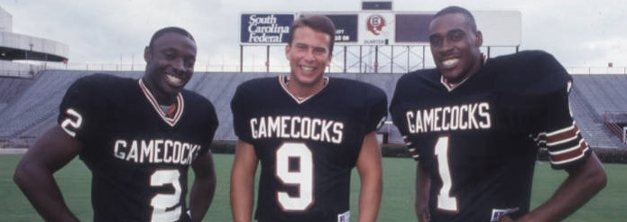
?

Slide 72
SOUTH CAROLINA 20 CLEMSON 7

Slide 74
Dixon Robertson prepared this presentation for the OSE 2021 Facility Directors Conference held October 20-22, 2021. Any opinions expressed in the presentation are his own, and do not reflect an official position of the State Fiscal Accountability Authority.

Slide 75
In the late 1970’s the University of South Carolina plans an 800-seat performing arts center. Presently, the Iran and Nancy Koger Foundation pledges five million dollars for what becomes known as the “Ira and Nancy Koger Center for the Arts.” The Kogers’ donation is based on the construction cost estimate for the center.
USC channels the donation through the Carolina Research and Development Foundation, a non-profit corporation operating exclusively for the benefit of the University.
Soon, the governments of Richland County and the City of Columbia express interest in the project. They approach USC and offer to participate if the seating is increased. Plans are revised to include a 2,256-seat auditorium, and estimated construction costs rise to $15 million.
The City and County contribute land and pledge $5.75 million toward construction of the larger center. Combined with the Koger gift this leaves a funding shortfall of nearly five million dollars.
USC continues to seek private donations. CRDF plans to borrow the difference if USC will pay interest on the note. Meantime, USC asks the Commission on Higher Education to approve a lease of the Center from CRDF.
With CHE approval, USC asks the Budget and Control Board to approve the lease. The Board makes no commitment to recommend the lease, and directs USC to submit it for approval at some time in the future. According to the Board’s records, no lease is ever presented for its approval.
The General Assembly includes $300,000 as a supplemental appropriation in the 1996 budge act for the Koger Center. In September 1986 USC makes the first lease payment of $802,500 to CRDF. Construction has not begun.
The stage is now set for 1987….

