Slide 1
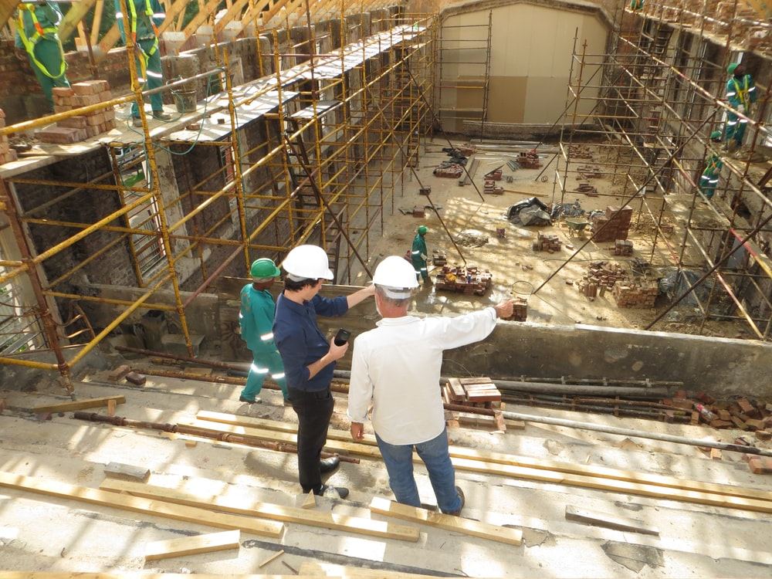
State Term Contracts Related to Construction

Slide 2
Getting to Know You
Does anyone have an unlimited budget?

Slide 3
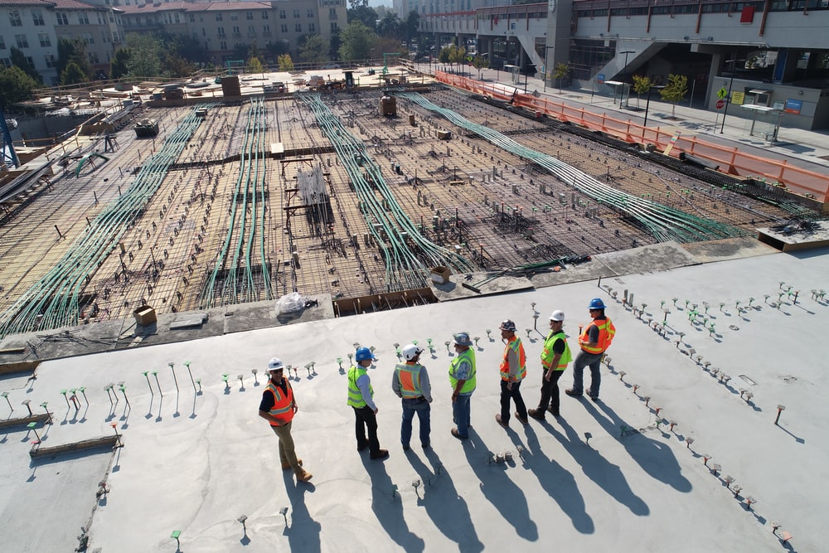
Getting to Know You
Who has more resources than you know what to do with?

Slide 4
Show of Hands:
How many of you are already familiar with the Office of State Procurement and State Term Contracts?

Slide 5
What we do
We put contracts in place for goods and services that are commonly used across agencies.
Notes:
Many of you are familiar with some of the state contracts we have in place like furniture, grounds maintenance equipment, MRO (Material, Repair and Operating) Supplies, or Professional Grade Tools and Equipment contracts, but today we are going to focus on state term contracts related to construction.
Professional Grade Tools and Equipment – Tools, tools and more tools.
Ballasts and Lamps
Equipment Rentals – Contracts include access to everything available for rental from United Rentals and Sunbelt Rentals.
Grounds Equipment Contracts – Phase I contracts are for the smaller mowers and associated equipment (mowers, chain saws, safety items, etc.) and Phase II contracts are more for large commercial (DOT) type applications (tractors, trailers, loaders, etc.).
Herbicides, Adjuvants and Blends - Contracts have both 2.5 Gallon or 15 Gallon containers.
Large Truck/Cargo Van Rentals – This is relatively new but has daily, weekly and monthly rentals of box trucks (with or without a lift gate) HD pickups and cargo vans.
MRO (Material, Repair and Operating) Supplies – Contacts include almost everything form Grainger, Fastenal, MSC and Noble Supply & Logistics. There are some restrictions on the purchase of equipment with a unit price higher than $10K.
Paper Towels, Toilet Paper & Dispensers
Sandbags – Filled or unfilled.
Temporary Staff Services – All contracts have lines for blue collar workers.
Trash Can Liners
Walk-In Building and Home Improvement Supplies – If it’s in Lowe’s, you can buy it. This contract is NOT meant for large projects.

Slide 6
Primary Goals of the State Term Contracting Team
Identify Contracting Opportunities
Acquisition Planning
Strategic Sourcing of State Term Contracts
Monitoring Contract Performance
Notes:
As the state term contracting team, we have 4 primary goals:
Identify Contracting Opportunities that are beneficial across the state
Acquisition Planning to ensure effectiveness of contracts
Strategic Sourcing of State Term Contracts
and
Monitoring Contract Performance

Slide 7
Statewide Term Contracts
Established by Goods & Services or Information Technology Teams for a specified period
Required use by state agencies and those governed by the SC Consolidated Procurement Code
Notes:
Optional use for Political Subdivisions, school districts, and any governmental entity created by an act of a political subdivision’s legislative body.
Not established for items in a volatile market.
Examples of volatile market: Antifreeze, Lubricants

Slide 8
Why Utilize State Term Contracts?
Save
Time
&
Money!
Notes:
(Economies of Scale)
We have already established that you are contracting for and buying items for your entities. We also established that you have limited time, resources, and money.
By utilizing state term contracts when possible, you recognize time savings. The contracts are already solicited, negotiated, awarded, and ready for you to use.
Because our office is establishing contracts for the entire state, we have more buying power. This leverage of buying power yields greater cost savings for everyone utilizing the contract... especially those smaller agencies, cities, counties, and municipalities that could never purchase on that level on their own.
We also conduct thorough acquisition planning to include market research and benchmarking against other states in the nation.
With the savings of time and money that are recognized, there is still a way to further increase your savings in certain markets…

Slide 9
Increase savings
Buy in bulk & ask vendor for additional discounted pricing.
Notes:
Because State Term Contracts are already priced so well, many people do not realize they can ask the vendor for lower pricing.
Don’t assume that vendors will not lower the state term contract pricing, especially when buying in higher quantities.
Keep in mind, there are some contracts that are priced so aggressively that vendors cannot lower their price without taking a loss, but it never hurts to ask the question.
Now I am going to highlight some of the state term contracts that are specifically related to construction. If you want to take a deeper dive, on any of the contracts, reach out to me and we can explore them further either with me or the Procurement Manager that handles the contract.

Slide 10
Ballast & Lamps
Start Date: 09/08/2017
End Date: 09/07/2022
DeAna Reed-Sharpe
Buy, replace, & recycle
Lot A Phillips Lot B Sylvania Lot C General Electric Lot D – Retrofit Service for Philips, Sylvania and General Electric Products – environmentally friendly, sustainable, green, alternate lighting solutions and options which are compatible with items in Lots A, B and C. Recycling of Lamps & Ballasts is also offered in this Lot.
Notes:
Ballasts and Lamps – Discount off of MSRP
All applicable items in the manufacturer’s catalog will be included in the contract at the same discounted rate offered and awarded on the contract.
Many people don’t know that this contract has a recycling component to it that would be very helpful to you guys.

Slide 11
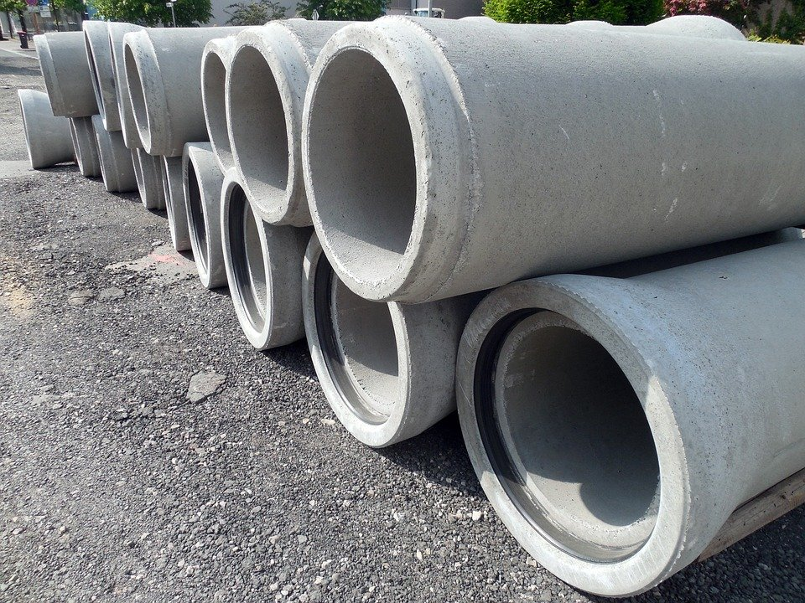
Concrete Culvert Pipe
Start Date: 08/02/2021
End Date: 08/01/2026
Michael Speakmon
Awarded suppliers are struggling with getting the wire mesh that goes in the pipes. Some suppliers have had to suspend taking orders until the market stabilizes.
Notes:
The vendors are having a hard time getting the wire mesh to reinforce the concrete pipe. Some vendors are not taking orders unless they know they can fulfill them, and two lots were not awarded because no one will bid on them. People in those areas can reach out to vendors from the other areas for assistance.
Below are the respective counties of the seven SCDOT Engineering Districts: District 1 - (Kershaw, Lee, Lexington, Richland, Sumter) District 2 - (Anderson, Abbeville, Edgefield, Greenwood, Laurens, McCormick, Newberry, Saluda) District 3 - (Greenville, Oconee, Pickens, Spartanburg) District 4 - (Cherokee, Chester, Chesterfield, Fairfield, Lancaster, Union, York) District 5 - (Darlington, Dillon, Florence, Georgetown, Horry, Marion, Marlboro, Williamsburg) District 6 - (Beaufort, Berkeley, Charleston, Colleton, Dorchester, Jasper) District 7 - (Aiken, Allendale, Bamberg, Barnwell, Calhoun, Clarendon, Hampton, Orangeburg) NOTE: We did not receive offers on District 5 & District 6. No contracts are awarded for those districts. This solicitation requires that all manufactures be pre-qualified by SCDOT to produce concrete culvert pipe before they can be eligible to bid. It does not require bidders to be pre-qualified producers of pipe in order to bid, but rather that all pipe delivered under the proposed contract be produced by a pre-qualified manufacturer. Therefore, any supplier can bid as long as the source of the pipe is from a pre-qualified manufacturer. REQUESTS FOR QUALIFICATION Producers should make a written request to be included on SCDOT QPL 69 to: Aly Hussein, Phd, PE Structural Materials Engineer S. C. Department of Transportation Office of Material & Research P.O. Box 191 Columbia, S.C. 29202 803-737-6687 husseinAA@scdot.org Eight (8) foot concrete pipe sections as the standard for all concrete pipe purchases. Pricing for the following diameter sizes 15”, 18”, 24”, 30”, 36”, 42”, and 48” is to be listed on the bid schedule (see Section VIII). Pipe will be provided to all counties and districts as part of SCDOT and any other qualified governmental entity throughout the State of SC and delivered by highway transport trucks to job sites as directed. The classification(s) of pipe ordered by SCDOT and other possible governmental entities will have pipe dimensions set at a minimum class of Class III. The classification of 18” RCP is to include both Class III and IV. All pipes must be supplied with joint material as specified on Qualified Product List and SCDOT Standard Specifications. DELIVERY DATE -- PURCHASE ORDER (MODIFIED) All items, except 18” Class IV, shall be delivered between seven (7) to fifteen (15) days after contractor’s receipt of the purchase order. 18” Class IV shall be delivered between fourteen (14) to thirty (30) days after contractor’s receipt of the purchase order. Required delivery for all eight (8) foot pipe diameters, except 18” Class IV is a maximum of fifteen (15) days after receipt of the purchase order. If the using governmental unit request delivery sooner than the time specified, contractor may invoice the ordering entity any additional shipping charges approved by the ordering entity on the purchase order. If any contractor cannot fulfill the seven (7) to thirty (30) days delivery requirement, a notice must be given within twenty-four (24) hours, either by telephone call (confirmed in writing) or facsimile, written notice or email, to the agency or government entity placing the order. Upon receipt of said notice, the ordering entity may elect to cancel its purchase order, regardless of the contractors’ production status, and source the supply elsewhere. The contractor is responsible for the difference in price between the contract price and the price procured elsewhere. It is up to each location to be responsible for any supplier that does not deliver within the terms of the contract. SHIPPING / RISK OF LOSS (MODIFIED) F.O.B. Destination. Destination is the shipping dock of the Using Governmental Units' designated receiving site, or other location, as specified herein. (See Delivery clause). Deliveries with a minimum forty-five thousand (45,000) lbs. load are to be shipped FOB Destination. Ordering entities may mix and match pipe sizes and adjust quantities to achieve the 45,000 lbs. threshold. All pipe that is delivered shall be offloaded by contractor at the designated loading area as shown on the agency or using governmental entity’s purchase order. Title will not pass to the ordering agency/entity until the unloading process is completed. Individual orders for less than 45,000 lbs. shall ship these orders prepaid, add the shipping charges to the invoice as a separate item and include in the invoice total for payment by the ordering agency/entity. SCDOT and all other ordering agencies/entities also have the option of making their own pickup and delivery from the vendor/contractor’s lot, thus saving payment for the shipping charges. The shipper must notify the consignee twenty-four (24) hours in advance when the shipment will be delivered. If the truck does not deliver the day specified or is more than four (4) hours late of the notified time of delivery, the consignee has the right to charge the delivering company $300.00 for late delivery.

Slide 12
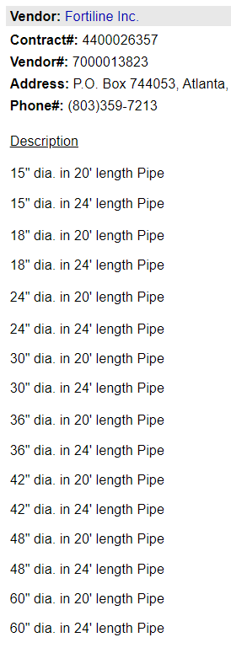
High Density Polyethylene (HDPE) Pipe
Start Date: 06/11/2021
End Date: 06/10/2026
DeAna Reed-Sharpe
Brand New State Term Contract
This contract required that all manufacturers be pre-qualified by SCDOT to produce HDPE pipe before they were eligible to bid.
Notes:
Purchase and delivery of High-Density Polyethylene (HDPE) Pipe throughout the State of South Carolina.
This solicitation requires that all manufacturers be pre-qualified by SCDOT to produce HDPE pipe before they can be eligible to bid. It does not require Offerors to be pre-qualified producers of pipe in order to bid, but rather that all pipe delivered under the proposed contract be produced by a pre-qualified manufacturer. Therefore, any supplier can bid as long as the source of the pipe is from a pre-qualified manufacturer.

Slide 13
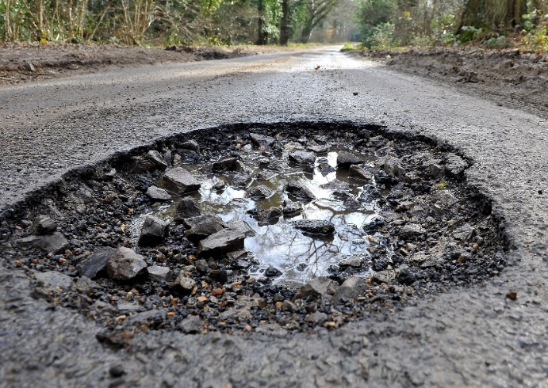
Cold Laid Asphalt Concrete Mixtures
Start Date: 04/01/2018
End Date: 03/31/2023
Portia Davis
Cold laid asphalt concrete surface mixture for use in maintenance patchwork.
The Contractor will be required to remove the old material if the product is deemed to have no useable value to the Department. The Resident Maintenance Engineer may deem the material is suitable for fill or other use if not used for its intended use as an asphalt surface repair patch.
Notes:
Cold laid asphalt concrete surface mixture is for use in maintenance patchwork. Under this contract, the Cold laid asphalt concrete surface mixture must be composed of aggregate and liquid asphalt from approved sources. Aggregates and liquid asphalt must be blended and prepared in an approved mixing plant. This material must consist of a cold laid asphalt concrete surface mixture for use in maintenance patchwork.
Concrete Mixture Type 2 Meeting Current SCDOT Specifications
The Contractor will be required to remove the old material if the product is deemed to have no useable value to the Department. The Resident Maintenance Engineer may deem the material is suitable for fill or other use if not used for its intended use as an asphalt surface repair patch.

Slide 14
Water Activated Pothole Patching
Start Date: 12/22/2019
End Date: 12/21/2022
DeAna Reed-Sharpe
Work will consist of furnishing a flexible water activated patching material that may be used “as-is” in any ambient temperature conditions typical to South Carolina for road maintenance patching operations.
Both vendors on contract, Fortiline, Inc. & SealMaster, offer the Aquaphalt brand of pothole patching material. Aquaphalt is an approved patching material manufacturer per South Carolina Department of Transportation.
Notes:
Water activated flexible pot-hole patch materials are for the SC Department of Transportation (SCDOT), and all other using governmental units throughout South Carolina. Product must be packaged in buckets or bags and must meet all of the requirements contained in the contract.
Work will consist of furnishing a flexible water activated patching material that may be used “as-is” in any ambient temperature conditions typical to South Carolina for road maintenance patching operations.
Both vendors on contract, Fortiline, Inc. & SealMaster, offer the Aquaphalt brand of pothole patching material. Aquaphalt is an approved patching material manufacturer per South Carolina Department of Transportation. No substitutions may be made. All items shall be delivered no later than thirty days after contractor's receipt of the purchase order. If the using governmental unit requests delivery sooner than the time specified, contractor may invoice the order

Slide 15
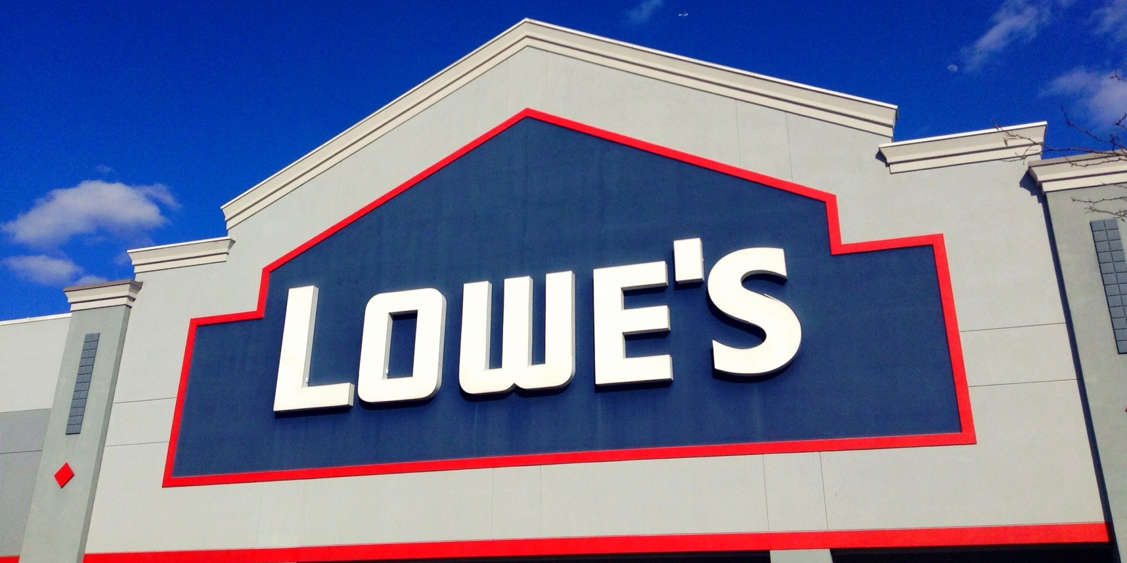
Walk-In Building & Home Improvement Supplies
Start Date: 10/02/2017
End Date: 07/31/2022
DeAna Reed-Sharpe
Convenience Contract / Non-Mandatory
This contract provides for a 7% DISCOUNT to the State and the convenience and flexibility of a walk-in, same day solution for access to materials, equipment and supplies.
This contact is not intended for large project purchases. It is intended for smaller needs (a few pieces of plywood or 2x4s, an extra bag of concrete, etc.). Total of purchases are limited to the P-card limits, purchase orders cannot be used on this contract.
Notes:
This contact is not intended for large project purchases. It is intended for smaller needs (a few pieces of plywood or 2x4s, an extra bag of concrete, etc.). Total of purchases are limited to the Pcard limits, purchase orders cannot be used on this contract.
Exclusions: This Participating Addendum excludes the purchase of Lamps and Ballasts; Paper Towels, Toilet Paper and Dispensers; and Can Liners; there are other Statewide Term Contracts for the purchase of these specific items. The Participating Addendum also excludes any other supplies that are similarly covered by separate Statewide Term Contracts. Please note that the Statewide Term Contracts for such products may require a minimum quantity order or may not meet a particular or exceptional operational need of a using organization (Examples: can liner that is exceptionally thick/strong or of an unusual color or size, paper products that will not fit a particular dispenser). In such situations, using entities may use this agreement to complete purchases to meet their specific operational needs. This Participating Addendum also excludes the use of Lowe’s Business Credit programs and plans.

Slide 16
Building Inspection & Testing Services
Start Date: 12/16/2019
End Date: 12/15/2024
Portia Davis
Fixed Price Bid that allows for suppliers to be added annually throughout the life of the contract.
The scope of inspection and testing services for a specific construction project are to be described in the purchase order.
A fully completed Inspection/Material Testing Order Form, OSE Form SE-955, must accompany a purchase order issued by a State public procurement unit.
Notes:
FPB where offerors can submit a maximum fixed price per hourly rate for each of the referenced categories.
Offers will be accepted up to the annual anniversary date of the initial award, and will be awarded within 30 days after the annual anniversary date of the initial award.
Contractor shall provide specific inspection and/or material testing services for a specifically identified construction project upon a Public Procurement Unit issuing to the Contractor a purchase order for services. The scope of inspection and testing services for a specific construction project shall be as described in the purchase order. The performance of Contractor's Services in response to the purchase order shall commence upon the execution of the purchase order by the Owner and shall remain in effect through the duration of the construction project and the construction contractor’s completion of the punch list. Contractor shall complete inspection and testing services required by a purchase order issued within the authorized term of the Contract even though the completion date may exceed the term of the Contract.
A fully completed Inspection/Material Testing Order Form, OSE Form SE-955, must accompany a purchase order issued by a State public procurement unit.

Slide 17
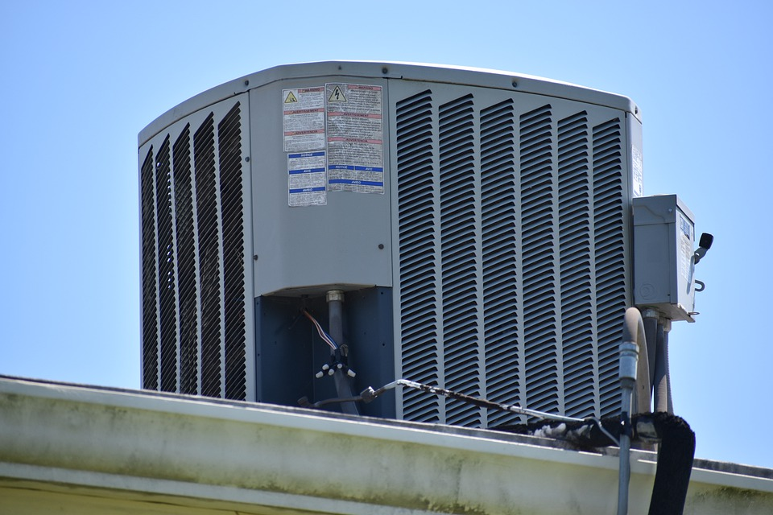
HVAC Testing, Adjusting & Balancing Services
Start Date: 11/13/2017
End Date: 11/12/2022
Portia Davis
TAB – General Services
TAB – Air Balance & Equipment Test
TAB – Water Balance & Equipment Test
TAB – Vibration Testing
TAB – Sound Testing
TAB – Reports
System Review
System Inspection
Duct Air Leakage Test
System Readiness Report
Notes:
IFB
Contractor will be responsible for providing Testing, Adjusting and Balancing (TAB) services as required by SC State using governmental units (UGUs).
These services include, but are not limited to:
Measurement and verification of HVAC system performance, with required reports
Restoration of HVAC systems to original, as built, performance parameters
Rebalance HVAC systems to accommodate new requirements, due to:
reconfiguration of existing space
change in use of space
replacement of existing equipment
updating outside air requirements
updating control sequences
changing exhaust systems
small, in-house, or IDC projects involving HVAC
periodic mandated performance certification
other ancillary work
Measurement of Vibration
Measurement of Sound
Contractor and all Contractor’s technicians providing TAB services to UGUs must be certified by either AABC (Associated Air Balance Council) or NEBB (National Environmental Balancing Bureau) to perform TAB services for HVAC, water balancing and sound and vibration testing (measurement only) of equipment and systems.
Contractor’s Lead Technician is to be an AABC certified Test, Adjust and Balance Engineer (TBE) or a NEBB certified professional in Testing Adjusting and Balancing.

Slide 18
Asbestos, Lead Paint, Mold Collection & Testing
Start Date: 05/20/2021
End Date: 05/19/2026
Michael Speakmon
LOT-1: Asbestos Testing & Reporting
LOT-2: Lead Based Paint Testing & Reporting
LOT-3: Limited Indoor Air Quality Survey- Mold Testing & Reporting
LOT-4: Renovation Air Monitoring
LOTS-5 through 7: Lab Fees
New State Term Contract
Notes:
SUBMISSION OF OFFERS AFTER THE INITIAL SUBMISSION DEADLINE.
During the term of this contract, the State will consider additional offers submitted for the Asbestos/Lead Paint/Mold Collection & Testing Term Contract. Vendors that wish to be considered during the contract term must submit offers to the Materials Management Office according to the instructions contained herein by the following Submission Schedule:
SUBMISSION DEADLINE 2: NOVEMBER 19, 2021
SUBMISSION DEADLINE 3: MAY 19, 2022
SUBMISSION DEADLINE 4: MAY 19, 2023
Inspection and testing services provided under the resulting contract(s) are restricted to the specific services listed in the contract, and other services offered by the Contractor are prohibited under this contract.
UGUs who collect their own samples ARE required to use labs that receive a contract in response to this solicitation.
LOT-1: ASBESTOS TESTING AND REPORTING
Contractor (Inspector) will be provided with the planned renovation/demolition activities in an area requiring testing. With this information, Contractor will be expected to survey, carry out bulk sampling, and inspect for the presence of asbestos containing material in accordance with the most recent evaluation requirements of the EPA, National Emission Standards for Hazardous Air Pollutants (NESHAP), and SCDHEC asbestos inspection regulations. For any asbestos testing laboratory used, the Contractor must ensure and be able to prove that the laboratory selected is accredited under the National Voluntary Accreditation Program (NVLAP). The inspector will provide the lab’s NVLAP accreditation in the inspection report provided as part of this task (see ‘Report of Findings’ section below for more details on reporting). The Contractor shall be able to provide:
expedited lab analysis within 24 hours as needed and a full report within 5 business days OR
lab analysis within 72 hours and a full report within 30 calendar days.
LOT-2: LEAD BASED PAINT TESTING AND REPORTING
Contractor will test for the presence of Lead Based Paint by X-ray Fluorescence (XRF) Spectrum Analyzer method or Samples. Paint testing must be representative of painted surfaces in each room or area. The samples must be obtained by an inspector certified by the EPA and trained by an EPA-accredited training program. In addition, testing samples can only be processed by a NLLAP-accredited lead-based paint laboratory. The inspector will provide the lab’s National Lead Laboratory Accreditation Program (NLLAP) accreditation in the inspection report provided as part of this task (see ‘Report of Findings’ section below for more details on reporting). Contractor shall test for the presence of LBP by XRF or laboratory analysis of paint chip samples.
The Contractor shall be able to provide:
expedited lab analysis within 24 hours as needed and a full report within 5 business days OR
lab analysis within 72 hours and a full report within 30 calendar days.
LOT-3: LIMITED INDOOR AIR QUALITY SURVEY- MOLD TESTING AND REPORTING
Contractor will test for the presence of fungi/microbial growth on interior building components as well as airborne fungal concentrations by carrying out a limited indoor air quality (IAQ) survey. As there are currently no established Federal or State standards for mold spore concentrations in an interior space, the composition of indoor airborne fungi is to be compared with the outdoor airborne fungi. Generally, indoor airborne fungi should align with the diversity of outdoor airborne fungi, but at lower concentrations. Sample analysis should follow analytical methods recommended by the American Industrial Hygiene Association (AIHA), the American Conference of Governmental Industrial Hygienists (ACGIH), or other professional organizations. The Contractor will provide the lab’s Environmental Microbiology Laboratory Accreditation Program (EMLAP) accreditation in the report provided as part of this task.
The task will include:
Visual reconnaissance of the areas of concern
Collection of interior and exterior air samples for particulates, including fungal spores and fragments that are sent to be processed by an EMLAP-accredited laboratory.
Measurement of general air quality including CO₂, temperature, humidity, and dew point.
Collection of tape-lift/tape slide samples of suspect fungal conditions that are sent to be processed by an EMLAP-accredited laboratory to identify mold types.
Provision of a written report of findings. (see ‘Report of Findings’ section below for more details on reporting).
The Contractor shall be able to provide:
expedited lab analysis within 24 hours as needed and a full Report of Findings within 5 business days OR
lab analysis within 72 hours and a full Report of Findings within calendar 30 days
LOT-4: RENOVATION AIR MONITORING
Contractor shall provide asbestos air monitoring during demolition of property containing asbestos materials.
Monitoring will require the services of an SCDHEC-licensed asbestos air monitor. All samples will be collected in accordance with Federal, State, and local standards and requirements and with accepted industrial hygiene acceptable methods and procedures. The most current edition of any relevant regulation, document, or code shall be in effect for the purpose of this contract. Where conflict among the requirements or with these specifications exist, the most stringent requirements will be utilized.
Air Monitoring must begin with background monitoring (PCM), prior to the start of asbestos removal. This will establish a baseline.
Daily air monitoring (PCM) shall be conducted during all hour’s asbestos abatement activities are performed until asbestos removal is complete. This will require the operation of air pumps around the asbestos work area by the Asbestos air monitor(s) for the entire duration of the removal project.
Following the completion of asbestos removal, final clearance (TEM) continuous air monitoring shall be conducted at the completion of the project for a minimum of 2.5 hours to determine whether space meets clean air standard for re-occupancy. Clearance is for National Emission Standards for Hazardous Air Pollutants (NESHAP) size projects
The use of PCM for final clearance testing may be used as an alternative to TEM testing on smaller projects where TEM testing is legally required.
This work is not associated with the abatement contractor. In accordance with DHEC regulations, the air monitor cannot be affiliated with the asbestos inspector or removal contractor of the same project unless he/she can provide separate licenses for each discipline (Regulation 61-86.1, Section IV, (https://www.scdhec.gov/sites/default/files/media/document/R.61-86.1.pdf)).
LOTS-5 through 7: LAB FEES
The State has established three categories of lab fees:
Asbestos Testing Lab Fees
Lead Testing Lab Fees
Mold Testing Lab Fees
All labs responding to the solicitation must be accredited under the National Voluntary Accreditation Program (NVLAP) and provide proof of accreditation prior to performance.
Each category has several types of tests and turnaround times (TAT) that are common to each category, and the maximum price the State will pay for each test and associated TAT.
Contractors collecting samples are not restricted to use only the labs that receive a contract as a response to this solicitation. However, no matter what lab is used, the State will not pay any fees exceeding the maximum limit set by the solicitation.

Slide 19
Equipment Rentals
Start Date: 05/06/2021
End Date: 03/10/2026
Michael Speakmon
New State Term Contract
Heavy Equipment Rental
Notes:
This is relatively new, and you guys may not know about it yet.
Sunbelt Rentals, Inc. and United Rentals (North America), Inc.
Dozers, excavators, dump truck, fork lifts and so much more.
As you start to use these contracts we would like to know if there is equipment you are renting that is NOT covered by these contracts.

Slide 20
Vehicle Rental Services
Start Date: 12/01/2020
End Date: 05/20/2025
Ellicia Howard
Enterprise and Hertz are awarded on these Nationwide Vehicle Rental contracts. These contracts provide guaranteed rates for vehicle rental services nationwide (other than box truck).
Notes:
Box trucks are a separate STC we will talk about next.

Slide 21
Large Truck/Cargo Van Rentals
Start Date: 04/17/2021
End Date: 04/16/2026
DeAna Reed-Sharpe
New State Term Contract
Enterprise Leasing Co Southeast, LLC
Includes box trucks, heavy duty pickups, stakebed trucks, and cargo vans.
Mileage: All rates include a minimum number of miles (Daily-150 miles, Weekly-1050 miles, Monthly-2200 miles). The per mile rate applies once the minimum number of miles is exceeded.
Notes:
Large Truck/Cargo Van Rentals - Includes box trucks, box trucks with lifts, HD pickups, Stakebed trucks and cargo vans.
Mileage: All rates include a minimum number of miles (Daily-150 miles, Weekly-1050 miles, Monthly-2200 miles). The per mile rate applies once the minimum number of miles is exceeded. Authorized Drivers: Minimum age for the Cargo Van class is 18 years old. The Contractor, at their discretion, may require a minimum age of 21 for all other classes.

Slide 22
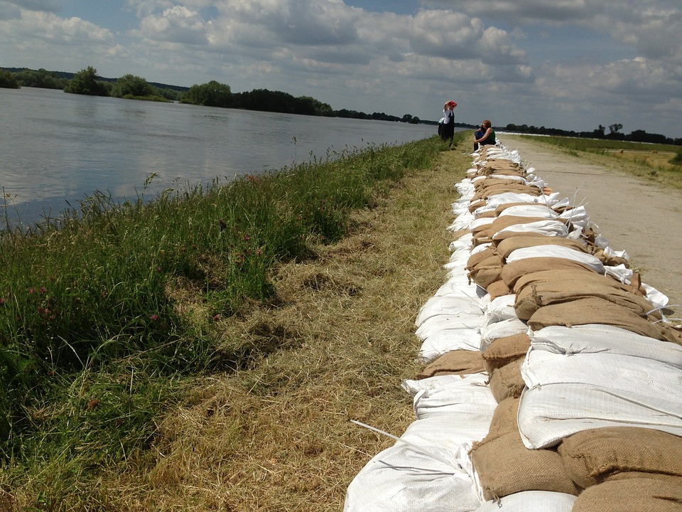
Sandbags
Start Date: 09/20/2019
End Date: 09/19/2024
Portia Davis
This is designed primarily for emergency use, but it is not limited to just that. Bags can be purchased empty or filled, and pricing is based on type and delivery times.
Notes:
This is designed primarily for emergency use, but it is not limited to just that. Bags can be purchased empty or filled, and pricing is based on type and delivery times.
This contract IS NOT limited for use only during support of emergency operations. It is available for use at any time during the contract. Under normal operating conditions, all deliveries shall be made and all services provided to the location specified by the Using Governmental Unit in its purchase order. Although a statewide contract, during declared emergencies in South Carolina, The South Carolina Emergency Management Division may choose to prioritize purchases to ensure sandbags are delivered to locations which support the State Flood Response Plan. During “State of Emergency” operations, contractors shall have the capability to arrange for pick-up or deliver empty or pre-filled sandbags throughout the state. ADDITIONAL CONSIDERATIONS: Contractor shall be responsible for the replacement of, and or any costs associated with the clean-up of any PRE-FILLED sandbags which are not properly and securely palletized and or prepared for shipping and are damaged or destroyed during transport.
Loading assets (fork lifts, etc.) will be provided by the contractor, at the loading point, with no additional charge to the State.
Delivery shall require the Contractor to perform the off-loading of sandbags at the point of delivery, unless otherwise stated by the ordering entity.
During State of Emergency operating conditions, contractors shall provide emergency contact information and be available to fulfill orders from The South Carolina Emergency Management Division, or its designee, 24 hours a day, 7 days a week.

Slide 23
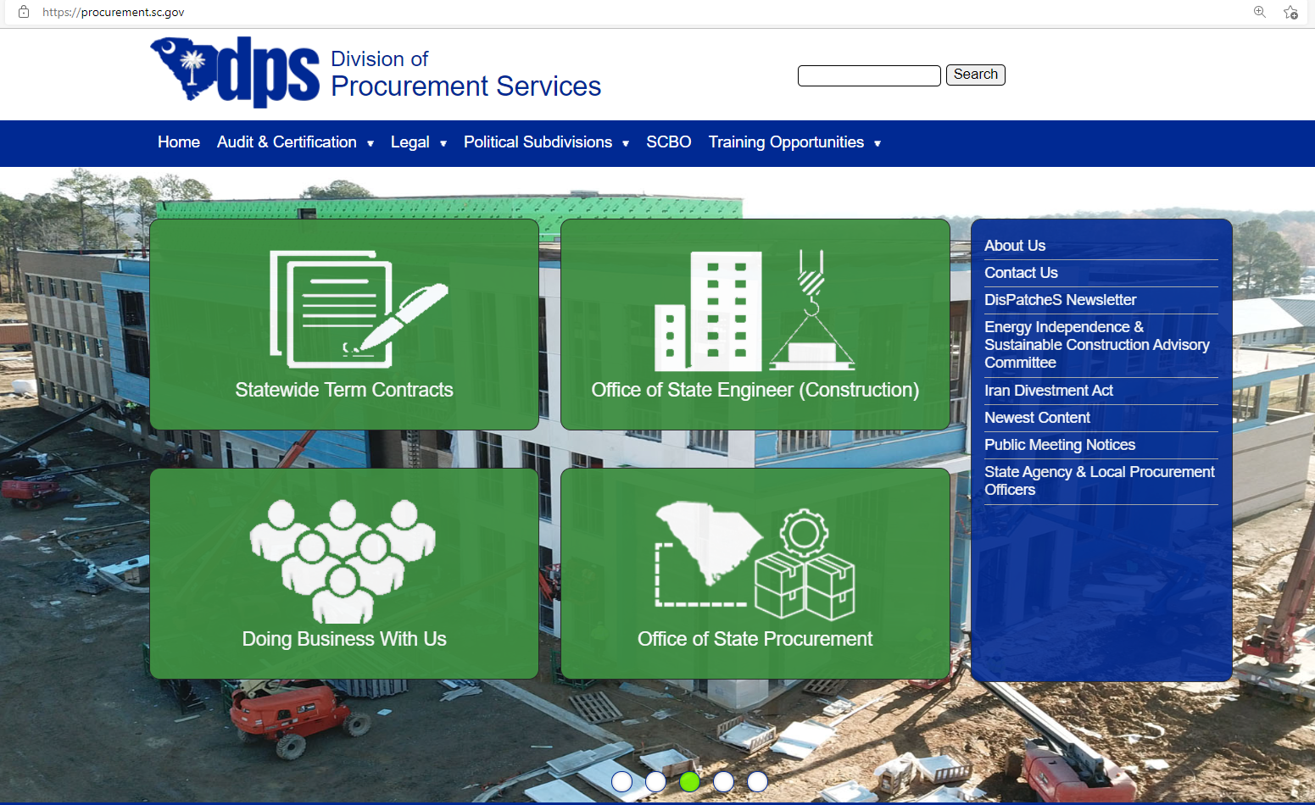
Access State Term Contracts
www.procurement.sc.gov

Slide 24
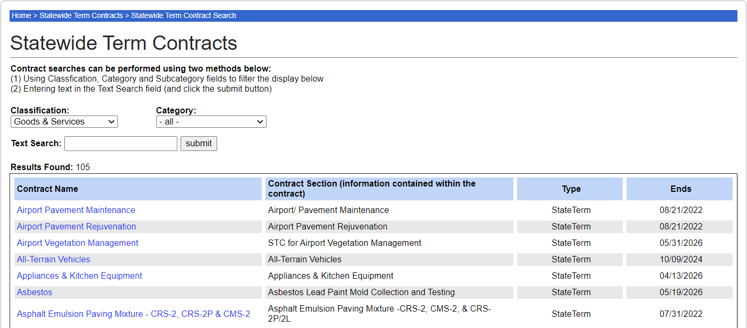
Access State Term Contracts
www.procurement.sc.gov

Slide 25
Great demand?
Notes:
If you do not see something you know there is a great demand for, let us know. We are happy to consider new state term contracts when we can validate enough usage and when we can validate the market is stable enough to maintain fixed pricing.

Slide 26
Identifying Contracting Opportunities
Anticipated Users
Anticipated Volume
dollars
& quantity
Continued Need
Market Stability
Level of Competition

Slide 27
DisPatcheS Newsletter
www.procurement.sc.gov
Notes:
As we are conducting market research to create new contracts and/or renew existing we communicate that using our Dispatches Newsletter. It is published monthly and is a free publication.

Slide 28
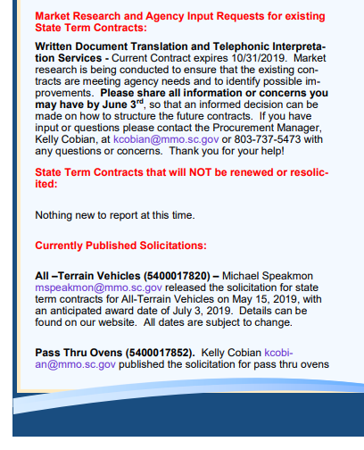

Slide 29
State Term Contracting Teams
Stacy Adams
Director of Statewide Sourcing
Michael Speakmon
Goods & Services Team Lead
Randy Barr
IT Team Lead
Portia Davis
Will Butler
DeAna Reed-Sharpe
Kristen Hutto
Ellicia Howard
Carol Norfleet

Slide 30
Contact Us
www.procurement.sc.gov

Slide 31
How can we better serve you?
We Are Always Willing To Help
Call Us at 803-737-0600
Visit our Website - www.procurement.sc.gov
Acquire
Administer
Advise

Slide 32
Stacy Adams, NIGP-CPP, CPPO, CPPB
sadams@mmo.sc.gov
Michael Speakmon, CPPO
mspeakmon@mmo.sc.gov
Randy Barr, CPPO
rbarr@mmo.sc.gov

