Slide 1
Office of state engineer database
Margaret Jordan, PE
Deputy State Engineer
Office of State Engineer

Slide 2
OSE database
New interactive Database and Web Application for State Construction Projects to be used by OSE and all State Agencies.
Designed to be:
Efficient,
Flexible,
Scalable,
Accessible, and
Easy to Maintain.

Slide 3
user account
Each agency will be allowed a maximum of 3 Users.
You will be provided a link to register your account.
Fill in contact information in My Profile:
Name, Agency, Address, Phone, Email Address.
Digital Signatures can be uploaded to be used on OSE forms.
Before you can start using the System, OSE will verify by Phone or Email that this is your account.

Slide 4
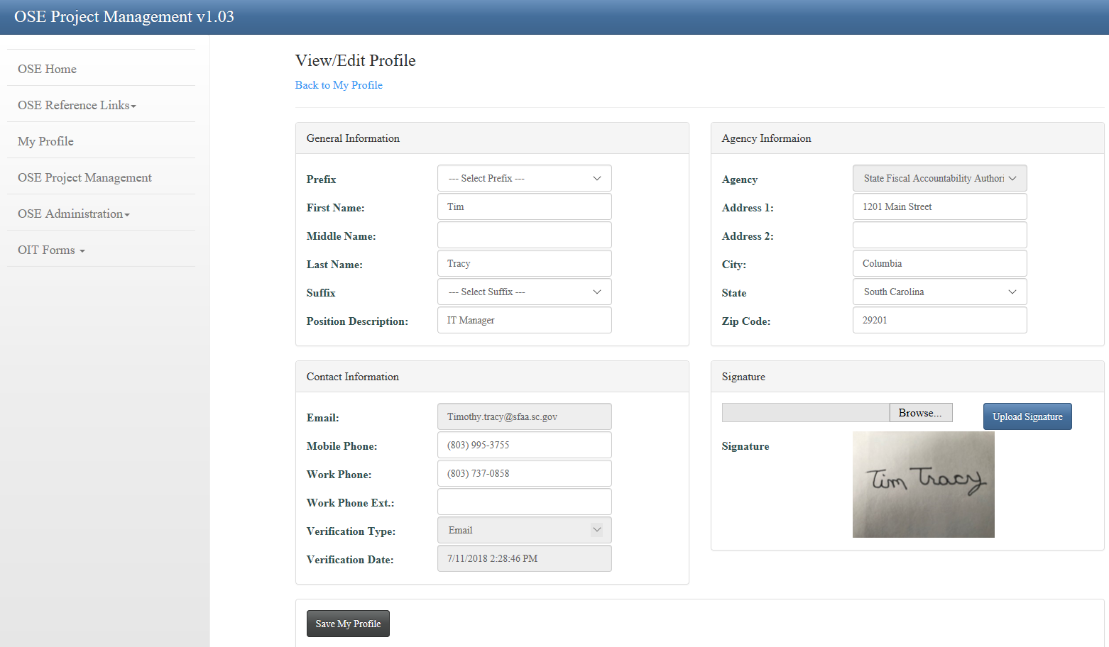
My Profile

Slide 5
Contact Information in database
This information will be available to all users, except as noted, and will be updated as necessary.
User Account Information (Semi-private thru “My Profile”)
Other State Agency Employees (limited information)
Architects and Engineers
Contractors
Other

Slide 6
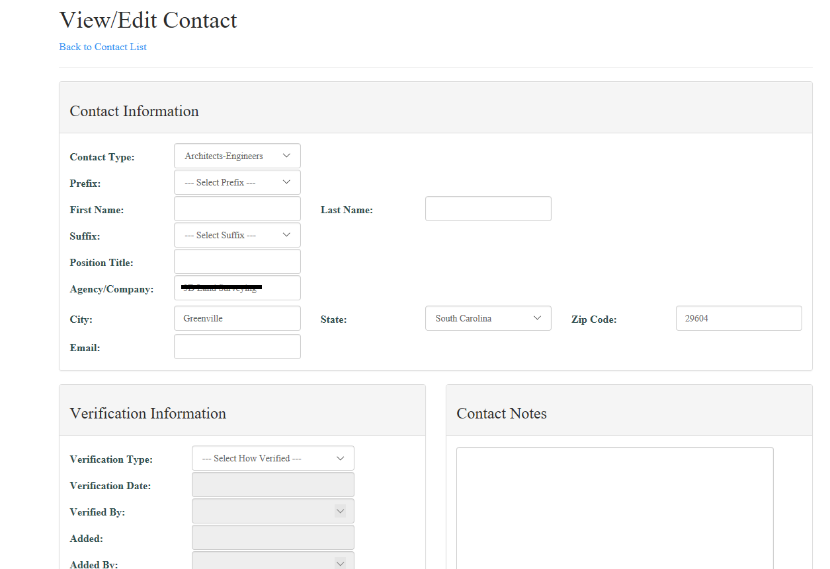
Contact Information

Slide 7
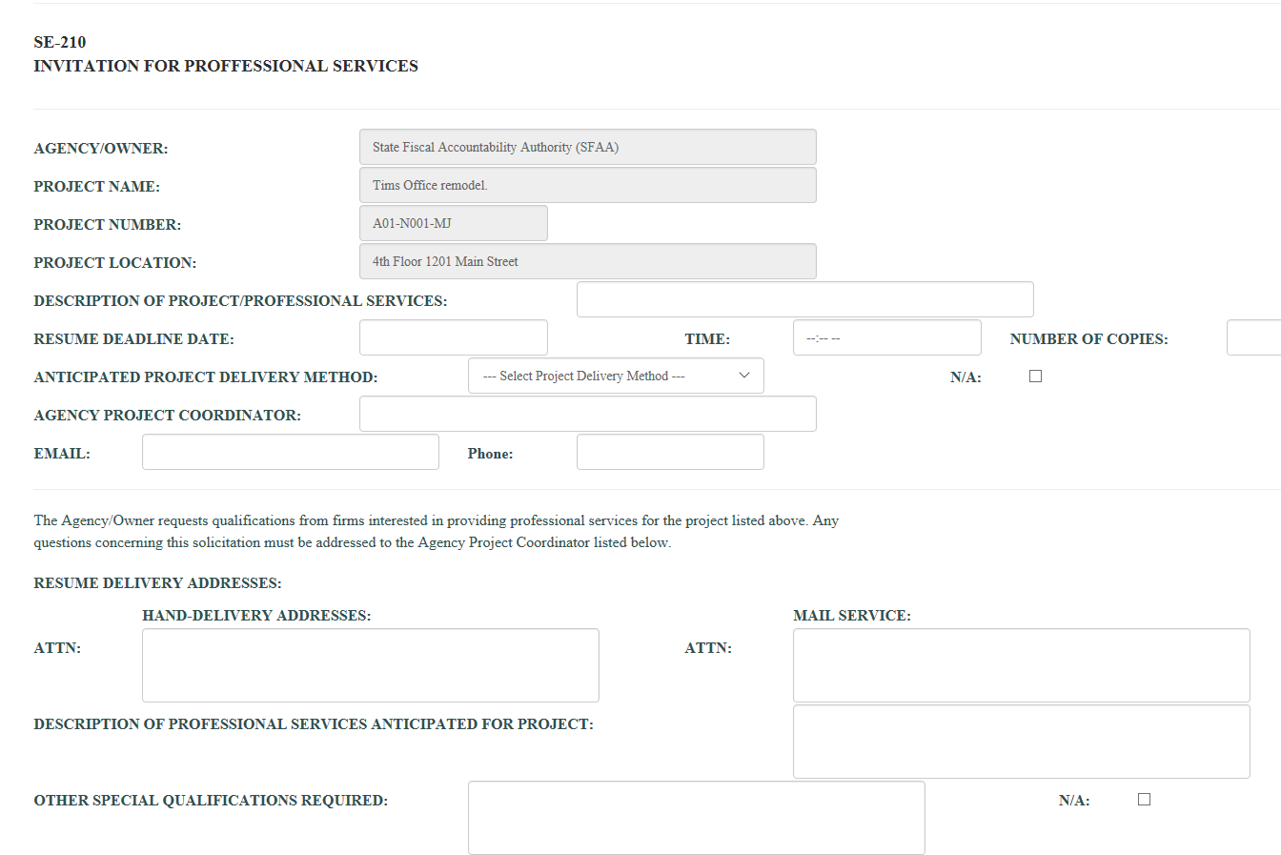
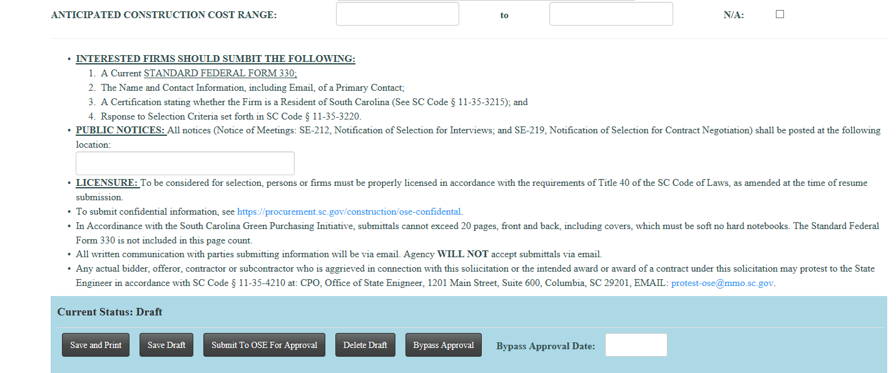
form Screen Shot: SE-210

Slide 8
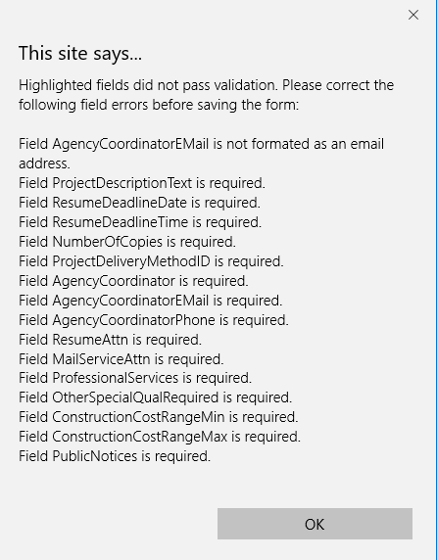
Form validation errors: SE-210

Slide 9
Form workflow status
Draft - OSE form is being worked on.
Submitted - OSE form has passed data requirements and waiting OSE approval.
Rejected - OSE has rejected the form and status is back to draft status.
Approved - OSE has approved the form.

Slide 10
Buttons visible by form status
Status - Draft:

Slide 11
Buttons visible by form status
Status – Submitted (state agency):

Slide 12
Buttons visible by form status
Status – Approved:

Slide 13
Ose Form Association
All forms that are associated with other forms must be submitted in the correct order or an error message will appear.
Example: SE210 -> SE-220 -> SE260.
SE-220 form will not be able to be entered until the SE-210 is approved.
SE-260 form will not be able to be entered until the SE-220 is approved.

Slide 14
Ose Form Association
Attempting to create SE-260 when a SE-220 has not be created.

Slide 15
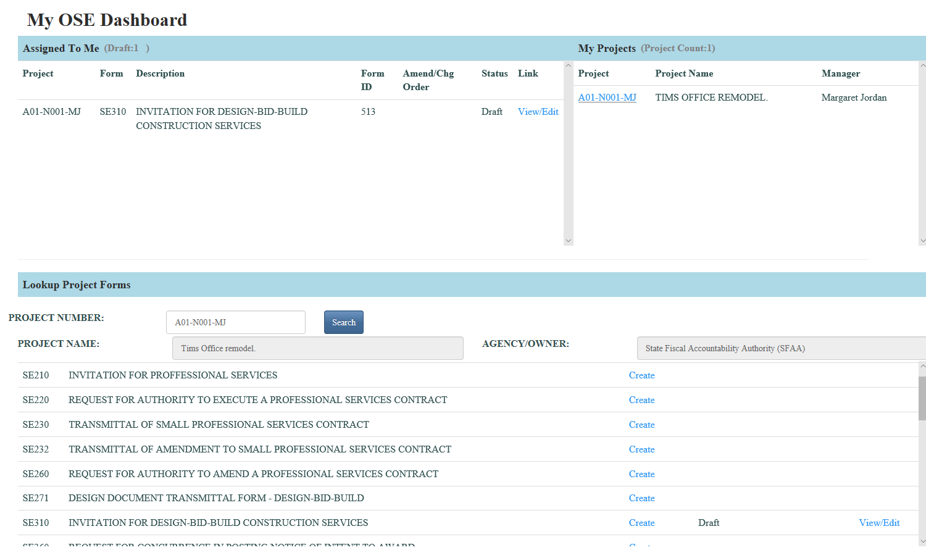
DashBoard used for all projects

Slide 16
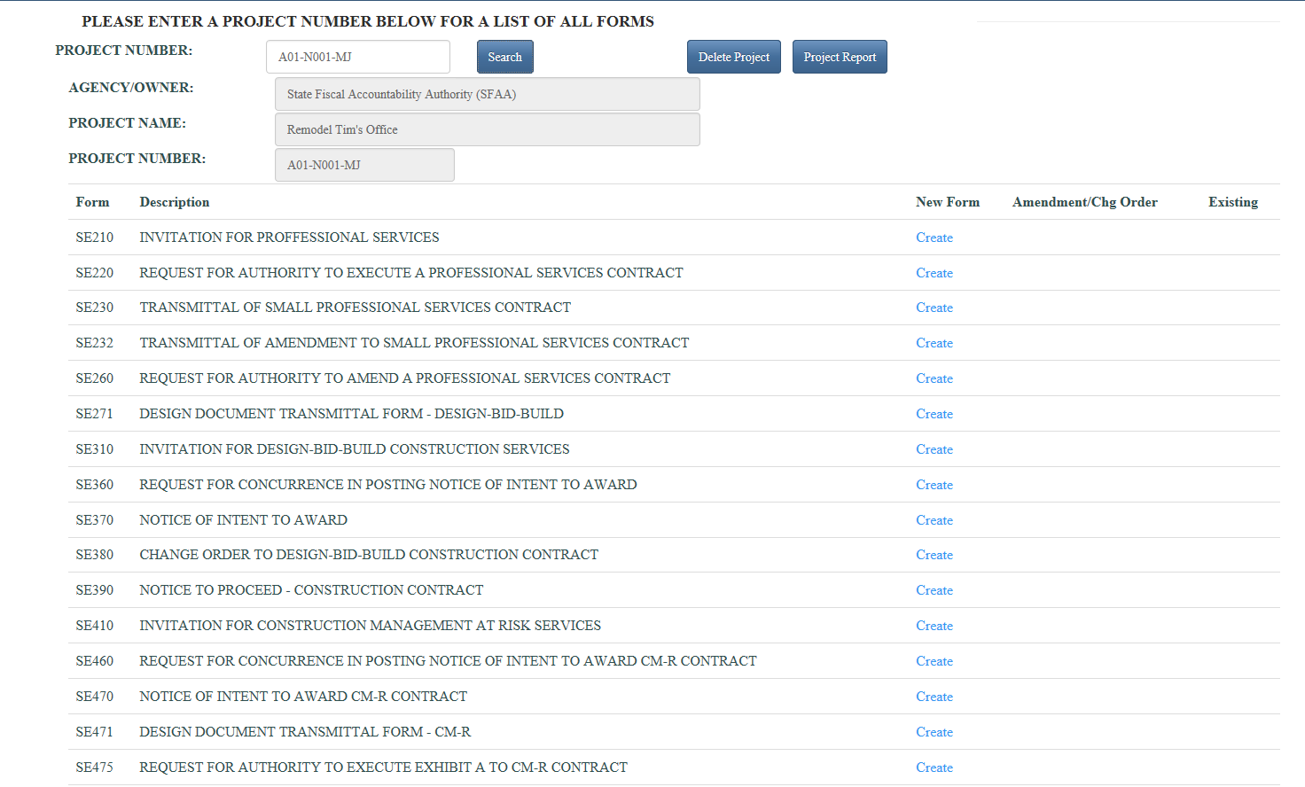
Single Project Management

Slide 17
access to projects
User will only be able to access your Agency’s Projects in the Database.

Slide 18
Q u e s t I o n s ? ? ?

