Slide 1
UNDERSTANDING THE BUILDING CODE AS IT RELATES TO YOUR PROJECT
Clint Burdett, AIA
OSE Project Manager
Office of State Engineer

Slide 2
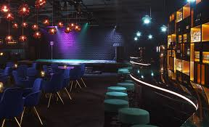
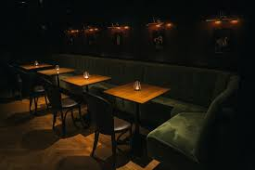

Slide 3
What is one of the most important roles of the A/E?

Slide 4
What is one of the most important roles of the A/E?
To protect the life safety and wellbeing of the occupants of the building or facility.

Slide 5
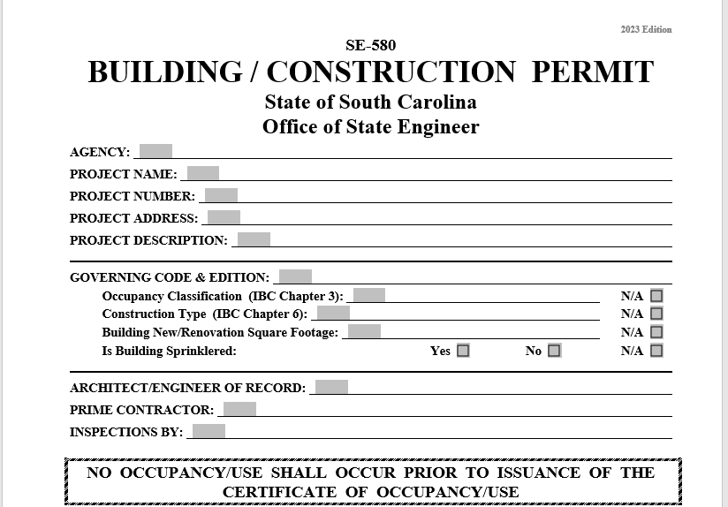

Slide 6
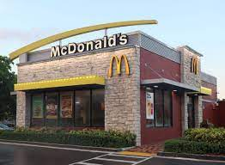
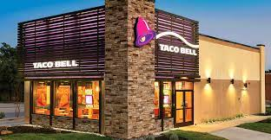

Slide 7
ASSEMBLY
GROUP A-2
TYPE V-B
5000 SQ.FT.
100 OCC

Slide 8
WHAT ARE THE TWO BIGGEST FACTORS THAT AFFECT A BUILDING OR STRUCTURES SIZE, HEIGHT & CONSTRUCTION TYPE?

Slide 9
WHAT ARE THE TWO BIGGEST FACTORS THAT AFFECT A BUILDING OR STRUCTURES SIZE, HEIGHT & CONSTRUCTION TYPE?
Occupancy Classification
Construction Type

Slide 10
OCCUPANCY CLASSIFICATION
What Occupancy is your project?
Assembly
Business
Educational
Factory
High Hazard
Institutional
Mercantile
Residential
Storage
Utility

Slide 11
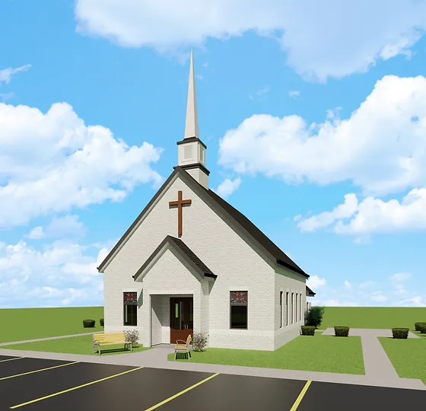
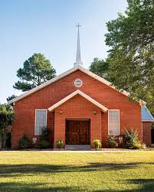

Slide 12
ASSEMBLY
GROUP A-3
TYPE V-B
12,000 SQ.FT.
300 OCC

Slide 13
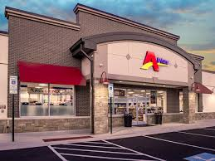
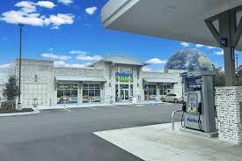

Slide 14
CONVENIENCE STORE
MERCANTILE
GROUP M
TYPE V-B
12,000 SQ.FT.
9,000 SQ.FT.

Slide 15
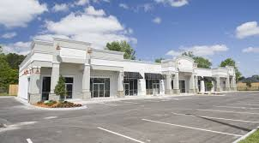
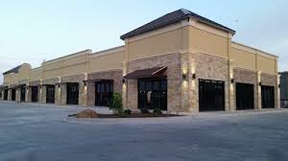

Slide 16
RETAIL
MERCANTILE
GROUP M
TYPE II-B
12,000 SQ.FT.
12,500 SQ.FT.

Slide 17
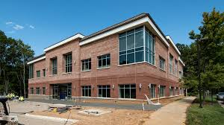
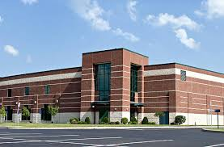

Slide 18
BUSINESS
GROUP B
TYPE II-B
V-B
9,000 SQ.FT.
II-B
23,000 SQ.FT.

Slide 19
MIXED USE & OCCUPANCY
What is your project?
Higher Education above the 12th grade, 20 classrooms with a 250 seat auditorium.
What is the building occupancy?

Slide 20
MIXED USE & OCCUPANCY
What is your project?
Higher Education above the 12th grade, 20 classrooms with a 250 seat auditorium.
What is the building occupancy?
The building will have a mixed use occupancy Group B & Group A-3

Slide 21
Knowing the code and the law and how it can affect your project.
Why would a Major Facility Project be designed under 10,000 sq. ft.?

Slide 22
Knowing the code and the law and how it can affect your project.
Why would a Major Facility Project be designed under 10,000 sq. ft.?
Any Major Facility Project larger than 10,000 gross sq. ft. shall be designed, constructed and certified as LEED or Green Globes.

Slide 23
Construction Type
Most expensive
Least expensive
Type I
Type II
Type III
Type IV
Type V
Noncombustible
Noncombustible
Noncombustible
& combustible
Mass Timber
Noncombustible
& combustible

Slide 24
Business sprinkled unprotected
12 stories
4 stories
4 stories
6 stories
3 stories
UL sq. ft.
Type II
Type III
Type IV
27,000 sq. Ft.
Type V
Type I
69,000 sq. ft.
57,000 sq. ft.
108,000 sq. ft.

Slide 25
Number of Exits
What occupant load requires 3 exits or even 4 exits?

Slide 26
Number of Exits
What occupant load requires 3 exits or even 4 exits?
3 exits are required with an occupant load over 500.

Slide 27
Number of Exits
What occupant load requires 3 exits or even 4 exits?
3 exits are required with an occupant load over 500.
4 exits are required with an occupant load over 1000.

Slide 28
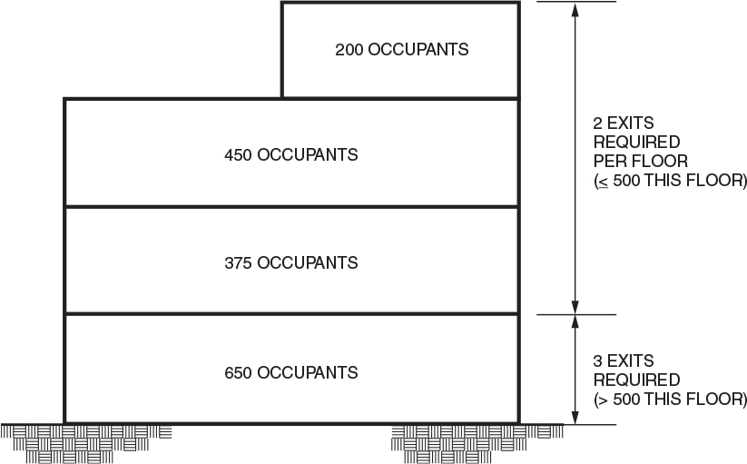

Slide 29
Atriums
An atrium is a space within a building that extends vertically and connects two or more stories?
When does an Atrium require smoke control?

Slide 30
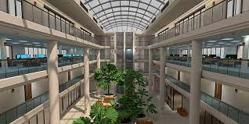

Slide 31
Atriums
An atrium is a space within a building that extends vertically and connects two or more stories?
When does an Atrium require smoke control?
Smoke control is required when 3 or more stories are connected.

Slide 32
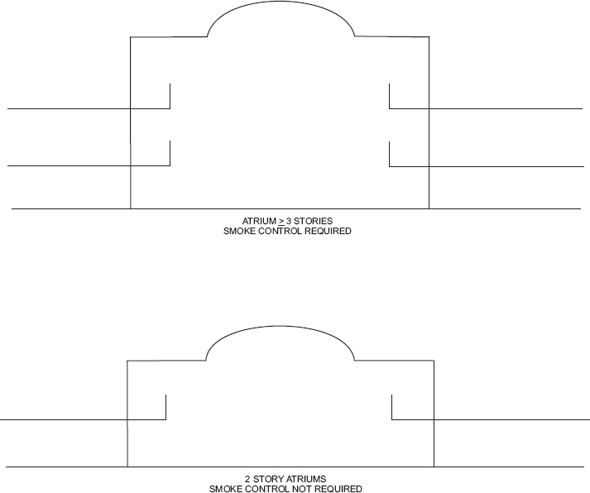

Slide 33
Standpipe Systems
When is a standpipe system required?

Slide 34
Standpipe Systems
When is a standpipe system required?
A standpipe system is required when the floor level of the highest story is located more than 30 feet above the lowest level of Fire Department access.

Slide 35
High Rise Building
A building with an occupied floor located higher than 75 feet.
Where are the measurements taken from to achieve the 75 feet?

Slide 36
High Rise Building
A building with an occupied floor located higher than 75 feet.
Where are the measurements taken from to achieve the 75 feet?
The measurement is from the lowest level of fire department vehicle access to the floor of the occupied level.

Slide 37
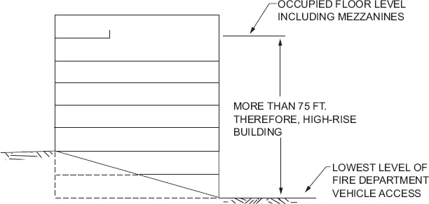

Slide 38
Small buildings and tenant spaces/small assembly spaces
A building or tenant space/room or space that is used for assembly purposes with an occupant load of less than 50 persons or less than 750 sq. ft. shall be considered as a Group B occupancy.

Slide 39
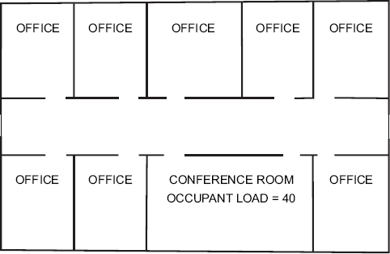

Slide 40
Posting of the Occupant load
At what point in a room or space should you post a sign stating the occupant load of the room?

Slide 41
Posting of the Occupant load
At what point in a room or space should you post a sign stating the occupant load of the room?
Every room or space that is an assembly occupancy shall have the occupant load of the room or space posted in a conspicuous place.

Slide 42
When do you need two exits out of a room or space?
When the occupant load is over 50 persons

Slide 43
How far apart do the exit doors need to be?
1/2 the distance of the diagonal un-sprinkled and 1/3 the distance of the diagonal sprinkled

Slide 44
When do you need to use exit signs?
When the occupant load is over 50 persons
When can exit signs be eliminated ?
Rooms or areas with only one exit
Main exterior exit doors that are obvious
Sleeping units or dwelling units

Slide 45
Separate toilet facilities
Where plumbing fixtures are required, separate facilities shall be provided for each sex.
Exceptions:
Separate facilities shall not be required in structures or tenant spaces with a total occupant load, including both employees and customers, of 15 or fewer.
Separate facilities shall not be required in mercantile occupancies in which the maximum occupant load is 100 or fewer.
Separate facilities shall not be required in business occupancies in which the maximum occupant load is 25 or fewer.
Separate facilities shall not be required to be designated by sex where single-user toilets rooms are provided in accordance with Section 2902.1.2.

Slide 46
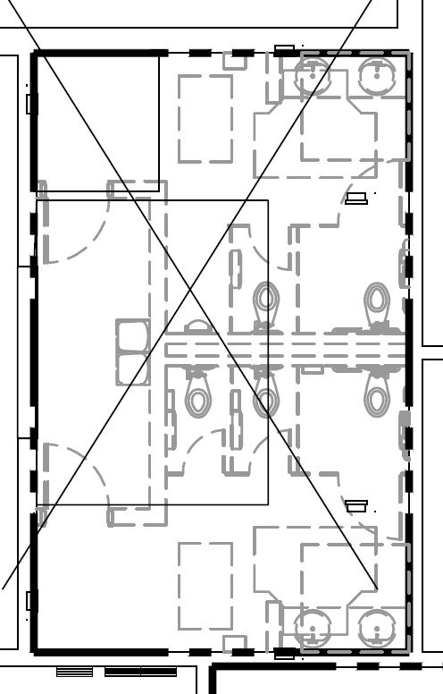
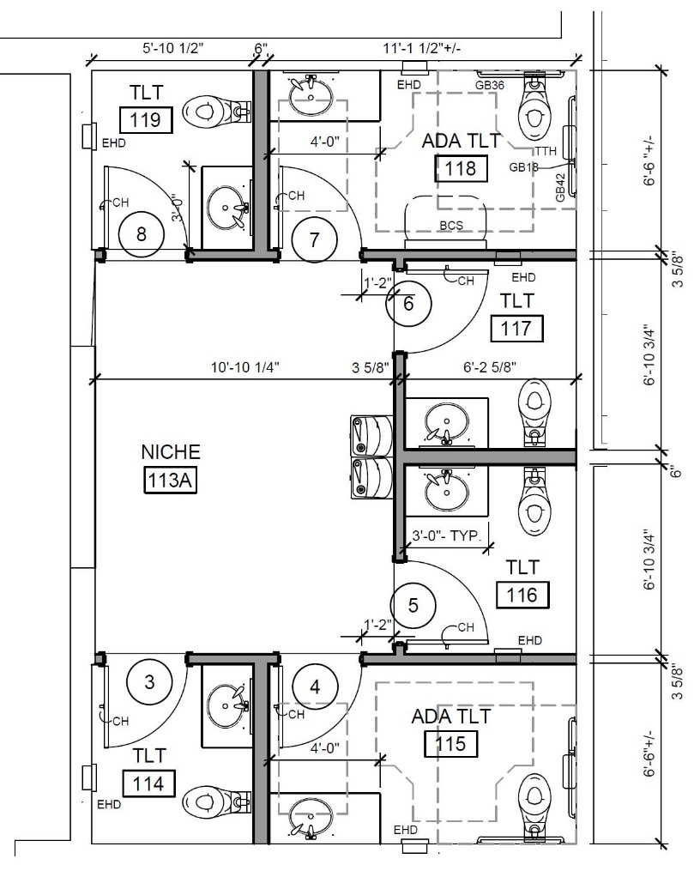
Before
After

