Slide 1
Know Your
Construction Contracts:
A201 –
A Keystone Document
Linda A. Ciaccia RA NCARB
2023 OSE Facility Directors Conference

Slide 2
Role of General Conditions:
It is adopted by reference in the Owner-Architect, Owner-Contractor, and Contractor-Subcontractor agreements = ‘keystone’ between the documents
Sets forth the rights, responsibilities and relationships of the Owner, Contractor and Architect, and provides terms and conditions under which all will work together during the construction process
The Architect participates in the preparation of the contract documents and performs construction phase duties, although not part of the Owner-Contractor agreement

Slide 3
Table of Articles:
1 - General Provisions
2 - Owner
3 - Contractor
4 - Architect
5 - Subcontractors
6 - Construction by Owner or by Separate Contractors
7 - Changes in the Work
8 - Time
9 - Payments and Completion
10 - Protection of Persons and Property
11 - Insurance and Bonds
12 - Uncovering and Correction of Work
13 - Miscellaneous Provisions
14 - Termination or Suspension of the Contract
15 - Claims and Disputes
16 - Project Specific Requirements and Information

Slide 4
1 - General Provisions
The Contract Documents
What are the Contract Documents?
Owner-Contractor Agreement
Conditions of the Contract
Drawings & Specifications
Addenda issued prior to execution of the contract
The Advertisement
Instructions to Bidders
Contractor’s Bid
Modifications made after execution of the contract -
Change Orders
Construction Change Directives
Minor Changes in the Work

Slide 5
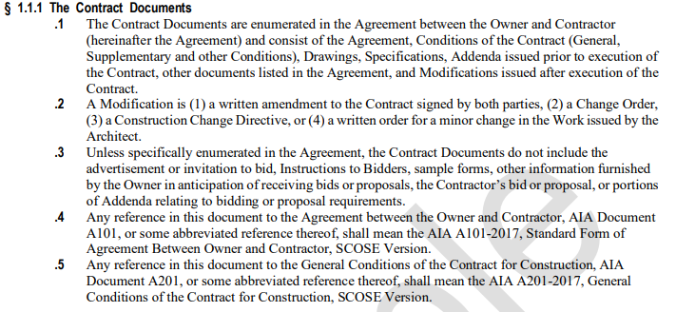
1 - General Provisions
The Contract Documents

Slide 6
1 - General Provisions
The Contract
What is the Contract?
The Contract Documents form the contract for construction and can be amended.

Slide 7
1 - General Provisions
Contract Documents
What is the intent of the contract documents?
To include all items necessary for the proper execution and completion of he work by the Contractor
The documents are complementary
In the event of ambiguities, the contractor shall provide better quality or greater quantity of work or comply with more stringent requirements, either or both, per Architect’s interpretation

Slide 8
1 - General Provisions
Notice to Proceed
What is established with the Notice to Proceed?
Notice to Proceed is issued by the Owner
SE-390 (D-B-B)
Date of Commencement
Contract Time
Substantial Completion
Liquidated Damages
Work with Contractor to establish dates

Slide 9
Table of Articles:
1 - General Provisions
2 - Owner
3 - Contractor
4 - Architect
5 - Subcontractors
6 - Construction by Owner or by Separate Contractors
7 - Changes in the Work
8 - Time
9 - Payments and Completion
10 - Protection of Persons and Property
11 - Insurance and Bonds
12 - Uncovering and Correction of Work
13 - Miscellaneous Provisions
14 - Termination or Suspension of the Contract
15 - Claims and Disputes
16 - Project Specific Requirements and Information

Slide 10
2 - Owner
Owner’s Right to Stop Work
When does the owner have the right to stop work?
When the Contractor fails to correct Work and/or repeatedly fails to carry out the Work in accordance with the Contract Documents
Lapse in insurance coverage

Slide 11
2 - Owner
Owner’s Right to Stop Work

Slide 12
2 - Owner
Owner’s Right to Carry Out the Work
When does the owner have the right to
carry out the work?
If the Contractor defaults or neglects to carry out the Work in accordance with the Contract Documents and fails within a ten-day period after receipt of written notice
Owner can be reimbursed for expenses and Architect’s additional services

Slide 13
2 - Owner
Owner’s Right to Carry Out the Work

Slide 14
Table of Articles:
1 - General Provisions
2 - Owner
3 - Contractor
4 - Architect
5 - Subcontractors
6 - Construction by Owner or by Separate Contractors
7 - Changes in the Work
8 - Time
9 - Payments and Completion
10 - Protection of Persons and Property
11 - Insurance and Bonds
12 - Uncovering and Correction of Work
13 - Miscellaneous Provisions
14 - Termination or Suspension of the Contract
15 - Claims and Disputes
16 - Project Specific Requirements and Information

Slide 15
3 - Contractor
Contractor & Applicable Codes
Is the contractor required to determine if the contract documents are in accordance with applicable laws and codes?
The contractor is not required to determine if the contract documents are in accordance with applicable laws and codes
If the contractor performs work knowing it to be contrary to applicable laws and codes, the contractor shall assume responsibility for such work and bear the costs to correct
Ask Architect for clarifications

Slide 16
3 - Contractor
Substitutions
What are they and how are they handled?
Owner & Architect may, but not obligated to, consider only if in full compliance with specs
Burden is on the Contractor to show that it meets or exceeds spec; includes same warranty; cost is complete including all related costs for any adjustments to the design (not including Architect’s services), waives claim for added costs; meets any sustainability requirements (if required)
Owner to cover services for A/E work; can get reimbursement from Contractor

Slide 17
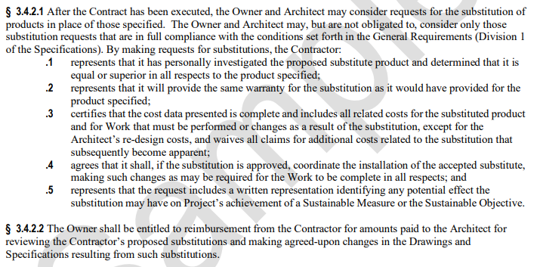
3 - Contractor
Substitutions
What are they and how are they handled?

Slide 18
3 - Contractor
Allowances
What are they and how are they applied?
Pre-determined amount of money for specific items (or group of items) that have not yet been selected or specified
Owner can delay making final decisions; typically finishes, equipment, hardware, etc.
Costs can be adjusted by Change Order
Not to be used as a substitute for items that typically fall under Contingency - unforeseen conditions, hazmat, etc. (Owner to protect funds in project budget for potential Contingency items)

Slide 19
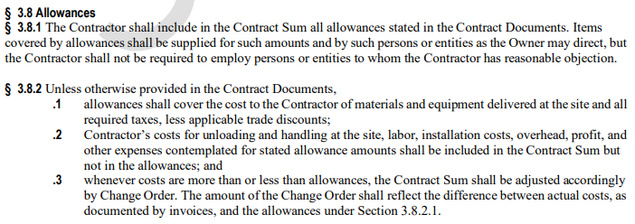
3 - Contractor
Allowances
What are they and how are they applied?

Slide 20
3 - Contractor
Superintendent
What is their role and does the Owner has a say?
They represent the Contractor, and communications given to them shall be binding as if given to the Contractor
As soon as practicable after award of the contract (NOIA), shall notify the Owner and Architect of the name and qualifications
Within 14 days of receipt, Owner may notify if they have ‘reasonable’ objections; no notice constitutes no objection
Cannot be changed without Owner’s consent

Slide 21
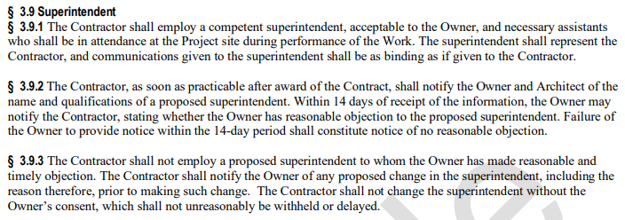
3 - Contractor
Superintendent
What is their role and does the Owner has a say?

Slide 22
3 - Contractor
Construction Schedules
When provided and how often should construction schedules be updated?
The Contractor shall prepare and submit a construction schedule for the work promptly after being awarded the Contract
The schedule shall be updated at appropriate intervals as required by the contract
The pay application requires an updated construction schedule, per Owner & Architect

Slide 23
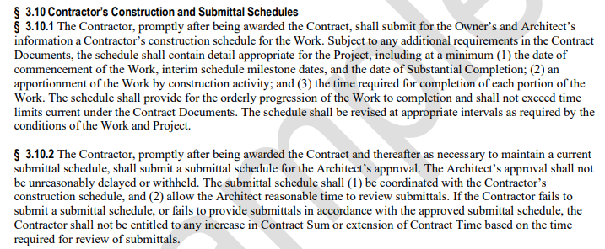
3 - Contractor
Construction & Submittal Schedules
When provided and how often updated?
Contractor to maintain current construction and submittal schedules throughout the project

Slide 24
3 - Contractor
Potential Workflow by PM
Once issue ‘Notice of Intent to Award’:
Finalize Superintendent – review & confirm (when ‘practicable’; required for O-C agreement)
Request Schedule – initial version should be provided; must be provided when submitting pay application (‘promptly’ after award; by reference – 14 days)
Request Subcontractor listing – review and comment within required timeframe (‘within 14 days after posting NOIA’)
Do not hesitate to ask for these items; the A201 requires them

Slide 25
3 - Contractor
Shop Drawings, Product Data and Samples
What do Shop Drawings represent?
Shop Drawings and similar submittals are not Contract Documents
Their purpose is to demonstrate how contractor proposes to conform to the design concept and information provided in the Contract Documents
Shop drawings are reviewed and approved by the contractor prior to submitting to the architect for approval

Slide 26
3 - Contractor
Fire Sprinkler Shop Drawings
Who prepares the Fire Sprinkler Shop Drawings and how are they submitted?
Prepared by a licensed sprinkler contractor; they shall certify the shop drawings and submit for review & approval
The architect’s engineer of record shall review, approve and submit to the State Fire Marshal for final review & approval
Prior to review by the State Fire Marshal (OSFM database), OSE to approve

Slide 27
3 - Contractor
Indemnification
What is Indemnification?
To the fullest extent permitted by law, the Contractor shall indemnify and hold harmless the Owner, Architect, Architect’s consultants, and agents and employees from and against claims, damages, losses and expenses, including attorneys’ fees, resulting out of the performance of the Work, but only to the extent caused by the negligent acts or omissions of the Contractor or a Subcontractor

Slide 28
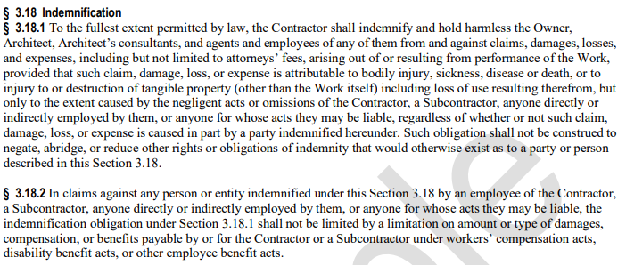
3 - Contractor
Indemnification

Slide 29
Table of Articles:
1 - General Provisions
2 - Owner
3 - Contractor
4 - Architect
5 - Subcontractors
6 - Construction by Owner or by Separate Contractors
7 - Changes in the Work
8 - Time
9 - Payments and Completion
10 - Protection of Persons and Property
11 - Insurance and Bonds
12 - Uncovering and Correction of Work
13 - Miscellaneous Provisions
14 - Termination or Suspension of the Contract
15 - Claims and Disputes
16 - Project Specific Requirements and Information

Slide 30
4 - Architect
Administration of Contract
What is the Architect’s role during the construction phase of the project?
Provide administration of the contract
Owner’s representative until the date that the final Certificate of Payment is issued
Have authority to act on behalf of the Owner only to the extent provided in the contract documents
Visit the site as necessary and keep Owner informed on the progress and quality of the portion of work completed

Slide 31
Table of Articles:
1 - General Provisions
2 - Owner
3 - Contractor
4 - Architect
5 - Subcontractors
6 - Construction by Owner or by Separate Contractors
7 - Changes in the Work
8 - Time
9 - Payments and Completion
10 - Protection of Persons and Property
11 - Insurance and Bonds
12 - Uncovering and Correction of Work
13 - Miscellaneous Provisions
14 - Termination or Suspension of the Contract
15 - Claims and Disputes
16 - Project Specific Requirements and Information

Slide 32
5 - Subcontractors
Their Role
Who are they and does the Owner have a say?
Person or entity that has a direct contract with the Contractor
Within 14 days after posting NOIA, Contractor must notify Owner and Architect of the entities proposed for each principal portion of the work (incl. those on Bid form)
Within 14 days of receipt, Owner may notify Contractor with reasonable objection; no notice constitutes no reasonable objection
Contractor shall propose another; contract can be adjusted (sum and time)

Slide 33
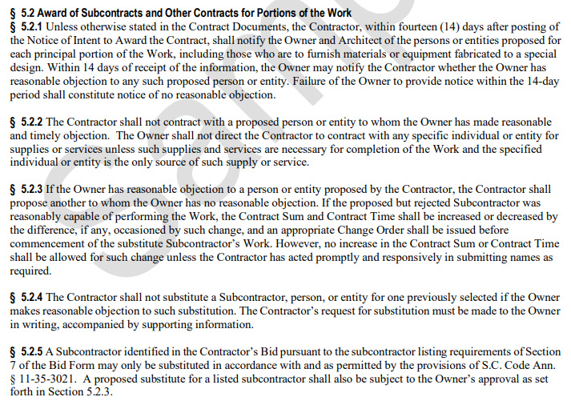
5 - Subcontractors
Their Role
Who are they and does the Owner have a say?

Slide 34
Table of Articles:
1 - General Provisions
2 - Owner
3 - Contractor
4 - Architect
5 - Subcontractors
6 - Construction by Owner or by Separate Contractors
7 - Changes in the Work
8 - Time
9 - Payments and Completion
10 - Protection of Persons and Property
11 - Insurance and Bonds
12 - Uncovering and Correction of Work
13 - Miscellaneous Provisions
14 - Termination or Suspension of the Contract
15 - Claims and Disputes
16 - Project Specific Requirements

Slide 35
6 - Construction by Owner or
Separate Contractors
Definition
Who are they? How is the Contractor affected?
Retained by the Owner under separate agreements
Can include work that is self-performed
Owner shall provide coordination of activities and the Contractor shall cooperate with them
Contractor can adjust schedule as required after a joint review / mutual agreement

Slide 36
Table of Articles:
1 - General Provisions
2 - Owner
3 - Contractor
4 - Architect
5 - Subcontractors
6 - Construction by Owner or by Separate Contractors
7 - Changes in the Work
8 - Time
9 - Payments and Completion
10 - Protection of Persons and Property
11 - Insurance and Bonds
12 - Uncovering and Correction of Work
13 - Miscellaneous Provisions
14 - Termination or Suspension of the Contract
15 - Claims and Disputes
16 - Project Specific Requirements and Information

Slide 37
7 – Changes in the Work
Impact of Changes
How are changes done & what is included?
Changes in the work can be made without invalidating the rest of the contract
Change Orders must be agreed to by the Owner, A/E, and Contractor – work scope, time, cost
Change Directives must be agreed to by the Owner and A/E and may or may not by the Contractor; cost can be determined in multiple ways (lump sum, unit prices, cost/fee, etc.)
A/E may order minor changes that do not impact time or contract sum

Slide 38
7 – Changes in the Work
Impact of Changes
How are changes done & what is included?
Overhead & Profit included
Contractor’s forces not to exceed 17%
Sub’s forces not to exceed 17%
Contractor’s subs not to exceed 10%
Must provide itemized accounting (labor, materials & supplies incl. transportation, machinery rental, bonds & insurance, etc.)
Percentage can vary, depending on scope
Determine % prior to requesting change

Slide 39
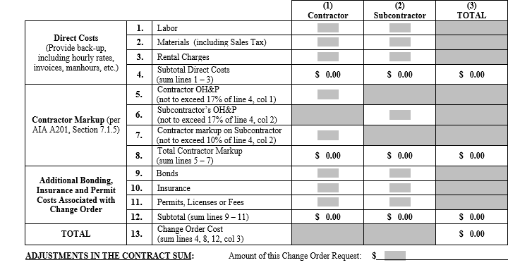
7 – Changes in the Work
Impact of Changes
‘Pg2’ document:
Can negotiate % with Contractor when requesting the change
When receive quote, verify correct % used

Slide 40
Table of Articles:
1 - General Provisions
2 - Owner
3 - Contractor
4 - Architect
5 - Subcontractors
6 - Construction by Owner or by Separate Contractors
7 - Changes in the Work
8 - Time
9 - Payments and Completion
10 - Protection of Persons and Property
11 - Insurance and Bonds
12 - Uncovering and Correction of Work
13 - Miscellaneous Provisions
14 - Termination or Suspension of the Contract
15 - Claims and Disputes
16 - Project Specific Requirements and Information

Slide 41
8 - Time
Contract Time
How is Contract Time Defined and Changed?
Contract Time is from Date of Commencement to Substantial Completion
Contractor will complete the work on time and work cannot start prior to effective date of insurance and bonds
Time may be extended for changes or other delays that are not the contractor’s fault

Slide 42
Table of Articles:
1 - General Provisions
2 - Owner
3 - Contractor
4 - Architect
5 - Subcontractors
6 - Construction by Owner or by Separate Contractors
7 - Changes in the Work
8 - Time
9 - Payments and Completion
10 - Protection of Persons and Property
11 - Insurance and Bonds
12 - Uncovering and Correction of Work
13 - Miscellaneous Provisions
14 - Termination or Suspension of the Contract
15 - Claims and Disputes
16 - Project Specific Requirements and Information

Slide 43
9 – Payments and Completion
Requirements for Payment
What is included in this section?
Contract sum
Schedule of Values
Applications for Payment
Certificate of Payment
Withholding Certification
Progress Payments Failure of Payment
Substantial Completion, Partial Occupancy

Slide 44
9 – Payments and Completion
Application for Payment
What is included & additional conditions?
Itemized application in accordance with the schedule of values, be notarized and reflect retainage
Can include equipment delivery & stored materials
Updated construction schedule
Contractor shall pay the Subcontractor within 7 days after receipt of payment
The owner can request written evidence from the contractor that subs have been paid

Slide 45
9 – Payments and Completion
Application for Payment
What is included & additional conditions?
Payment by the Owner does not constitute acceptance of the Work
If the Architect does not certify the pay request within 7 days of issuance or if the Owner does not pay within 21 days of issuance, then the Contractor may, upon 7 additional days written notice, Stop Work until paid

Slide 46
9 – Payments and Completion
Requirements for Completion
What is included?
Substantial Completion - when the Owner can occupy/use the work area for its intended purpose
Contractor requests & A/E inspects
Owner releases retainage
Partial Occupancy - can be applied to a portion of the work
Final Completion & Final Payment - Contractor to request

Slide 47
9 – Payments and Completion
Acceptance of Nonconforming Work
How is nonconforming work accepted?
The Owner can accept work that is not in accordance with the Contract Documents
The Owner may do so instead of requiring its removal and correction
If correction required, Contract Sum will be reduced as appropriate and equitable

Slide 48
9 – Payments and Completion
Final Completion and Final Payment
When is Final Completion achieved and
Final payment released?
If not agreed otherwise at Substantial Completion, Final Completion shall be within 30 days after Substantial Completion
Upon receipt of the Contractor’s written notice that work is ready for final inspection and receipt of the final pay request and final inspection has been performed

Slide 49
Table of Articles:
1 - General Provisions
2 - Owner
3 - Contractor
4 - Architect
5 - Subcontractors
6 - Construction by Owner or by Separate Contractors
7 - Changes in the Work
8 - Time
9 - Payments and Completion
10 - Protection of Persons and Property
11 - Insurance and Bonds
12 - Uncovering and Correction of Work
13 - Miscellaneous Provisions
14 - Termination or Suspension of the Contract
15 - Claims and Disputes
16 - Project Specific Requirements and Information

Slide 50
10 – Protection of
Persons and Property
Safety
Who is responsible?
Contractor is responsible for all safety precautions (typ. designates Superintendent)
Injury or Damage to Person or property - precautions shall be applied
Hazardous Materials – must notify Owner & Architect if unexpectedly encountered; Owner is responsible for remediation
Emergencies – Contractor to prevent damage, injury, loss; notify Owner & Architect

Slide 51
Table of Articles:
1 - General Provisions
2 - Owner
3 - Contractor
4 - Architect
5 - Subcontractors
6 - Construction by Owner or by Separate Contractors
7 - Changes in the Work
8 - Time
9 - Payments and Completion
10 - Protection of Persons and Property
11 - Insurance and Bonds
12 - Uncovering and Correction of Work
13 - Miscellaneous Provisions
14 - Termination or Suspension of the Contract
15 - Claims and Disputes
16 - Project Specific Requirements and Information

Slide 52
11 – Insurance and Bonds
Coverage
Who is responsible?
Other documents include specific insurance requirements provided by each party per the various agreements (O-A, O-C, C-S)
Contractor shall buy and maintain insurance and bonds as specified; if lapse in coverage, Date of Commencement can be delayed
If Contractor’s insurance is cancelled/expired, can stop work until resolved, but changes to contract time and sum will not be adjusted

Slide 53
Table of Articles:
1 - General Provisions
2 - Owner
3 - Contractor
4 - Architect
5 - Subcontractors
6 - Construction by Owner or by Separate Contractors
7 - Changes in the Work
8 - Time
9 - Payments and Completion
10 - Protection of Persons and Property
11 - Insurance and Bonds
12 - Uncovering and Correction of Work
13 - Miscellaneous Provisions
14 - Termination or Suspension of the Contract
15 - Claims and Disputes
16 - Project Specific Requirements and Information

Slide 54
12 – Uncovering and
Correction of Work
Responsibilities
How is it uncovering handled?
Contractor is responsible for making sure work remains visible (not covered) for any required inspections; will incur cost of uncovering / recovering
If Architect a requests uncovering that was not required initially, then Contractor entitled to adjustment in sum & time

Slide 55
12 – Uncovering and
Correction of Work
Responsibilities
How are corrections handled?
Within 1 year of Substantial Completion shall be corrected promptly after receipt of notice that it is needed
If the Owner fails to notify the Contractor during that 1-year period, they waive the rights to require correction by Contractor
Contractor bears cost of any damage caused by the correction process

Slide 56
Table of Articles:
1 - General Provisions
2 - Owner
3 - Contractor
4 - Architect
5 - Subcontractors
6 - Construction by Owner or by Separate Contractors
7 - Changes in the Work
8 - Time
9 - Payments and Completion
10 - Protection of Persons and Property
11 - Insurance and Bonds
12 - Uncovering and Correction of Work
13 - Miscellaneous Provisions
14 - Termination or Suspension of the Contract
15 - Claims and Disputes
16 - Project Specific Requirements and Information

Slide 57
13 – Miscellaneous Provisions
Tests & Inspections, Etc.
What is covered?
Tests & Inspections – Contractor to coordinate, Owner to pay
Owner's Materials – Contactor to store & protect; responsible for warranty & corrections
Interpretation of Codes – refer questions from local officials to Owner & OSE
Other Topics – Minority Business, Illegal Immigration, Drug Free Workplace, False Claims, Prohibited Act, Open Trade

Slide 58
Table of Articles:
1 - General Provisions
2 - Owner
3 - Contractor
4 - Architect
5 - Subcontractors
6 - Construction by Owner or by Separate Contractors
7 - Changes in the Work
8 - Time
9 - Payments and Completion
10 - Protection of Persons and Property
11 - Insurance and Bonds
12 - Uncovering and Correction of Work
13 - Miscellaneous Provisions
14 - Termination or Suspension of the Contract
15 - Claims and Disputes
16 - Project Specific Requirements and Information

Slide 59
14 – Termination or Suspension
of the Contract
Termination & Suspension
When are these applied?
Termination by Contractor – if work is stopped, national emergency, nonpayment
Termination by Owner for Cause – not following CDs, not paying subs, not following codes/laws
Suspension by Owner for Convenience – can suspend for a period of time, but must adjust contract sum & time
Termination by Owner for Convenience – must pay for completed work; potentially can be reinstated

Slide 60
Table of Articles:
1 - General Provisions
2 - Owner
3 - Contractor
4 - Architect
5 - Subcontractors
6 - Construction by Owner or by Separate Contractors
7 - Changes in the Work
8 - Time
9 - Payments and Completion
10 - Protection of Persons and Property
11 - Insurance and Bonds
12 - Uncovering and Correction of Work
13 - Miscellaneous Provisions
14 - Termination or Suspension of the Contract
15 - Claims and Disputes
16 - Project Specific Requirements and Information

Slide 61
15 – Claims and Disputes
Additional Cost & Time
What is included?
Continuing Contract Performance – Adjusting sum and time per Architect’s decisions; issue Certificates for Payment
Contractor not entitled to more time, if at fault for delays
Contractor & Owner to resolve disputes; Architect to assist Owner within defined timeframes
Further dispute resolution also included

Slide 62
15 – Claims and Disputes
Weather Days
How many days of adverse weather are anticipated at the job site each month?
Conditions abnormal & documented and had an adverse affect on the schedule
Adverse weather for each month = 5 days
Contractor can claim additional days
Contractor must submit rain days with monthly pay request
Once reviewed & approved, will be included in next Change Order

Slide 63
15 – Claims and Disputes
Delays
Can additional time be given?
Provide detailed account of circumstances and dates that caused the delays
Contractor is not entitled to additional days for items that are concurrent or interrelated
Owner can require a revised construction schedule, including any additional affected activities

Slide 64
Table of Articles:
1 - General Provisions
2 - Owner
3 - Contractor
4 - Architect
5 - Subcontractors
6 - Construction by Owner or by Separate Contractors
7 - Changes in the Work
8 - Time
9 - Payments and Completion
10 - Protection of Persons and Property
11 - Insurance and Bonds
12 - Uncovering and Correction of Work
13 - Miscellaneous Provisions
14 - Termination or Suspension of the Contract
15 - Claims and Disputes
16 - Project Specific Requirements and Information

Slide 65
16 – Project Specific
Requirements and Information
As required, by the Project
The A201 is not editable
Examples -
List any clarifications or modifications to the existing text in the document
List any additions, specific to the existing categories
For CM-R project, list and attach ‘Standard Modifications to AIA A201-2017, SCOSE Version, CM-R Project’ (see Appendix C)

