Slide 1
Protests & Contract Controversies: Lessons Learned
Manton Grier, Jr.

Slide 2
Protests by the numbers
From Jan. 1, 2022, to Present
Protests | 13
Denied | 6
Granted | 5
Denied in part, granted in part | 1
Withdrawn | 1
Appealed to the Panel | 0

Slide 3
Contract Controversies by the numbers
From Jan. 1, 2022, to Present
Contract Controversies | 4
Dismissed | 1
Withdrawn | 1
Pending | 1
Decision by the CPOC | 1
Appealed (in part) to the Panel | 1

Slide 4
Panel Appeals

Slide 5
Appeal by Narmour Wright, 2022-2
Filed in 2021
Protest of non-responsibility determination of A/E firm evaluated under Section 11-35-3220
Facts: After evaluation, but prior to award, another firm had bought all assets and took all but two employees (“no longer same firm we evaluated”)
Result: CPO found there was a rational basis to find new firm non-responsible, and Panel affirmed
Lesson Learned: You have broad discretion in matters of determining responsibility, because it is a business judgment and the agency has to live with the determination

Slide 6
Appeal by Rosenblum Coe Architects, 2022-4
Protest of misapplied evaluation factors under Section 11-35-3220 for A/E qualifications
Facts: Under criterion for “volume of work” awarded by agency in past five years, firm with one contract worth $1.8m was scored higher than firm with five contracts valued at just over $700k.
Result: CPO granted the protest, finding the number of contracts awarded, without considering value, failed to meet legislative intent of “effectuating an equitable distribution of contracts.” Panel affirmed.
Lesson learned: “Volume of work” means looking at more than raw number of contracts; consider value of those contracts too.

Slide 7
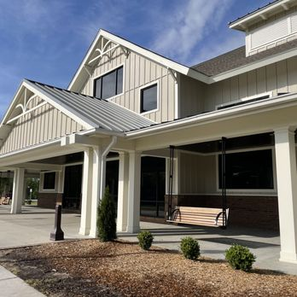
Appeal by SNB of Dillon (contract controversy)
No appeal to bulk of John White’s decision; filed reconsideration of claim for statutory interest and some other fees and deductions; still pending
Background: Construction of new welcome center on I-95 in Dillon
Agreement date: Nov. 1, 2018
Notice to proceed: Jan. 28, 2019
Original substantial completion date: Dec. 8, 2019
A/E certifies substantial completion: Aug. 4, 2021

Slide 8
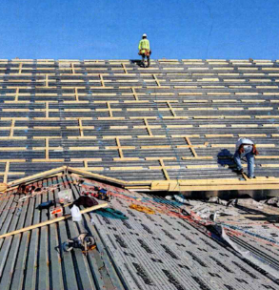
Appeal by SNB of Dillon
Claims for unresolved changes to roof sheathing
Plans called for perpendicular nailers to allow venting but SNB installed horizontal nailers too
Drawings showed some blocking, but A/E testified this applied only to sheathing on joists or trusses
SNB had to remove sheathing and cut nailers to allow venting—and wanted compensation
Claim denied
Lesson learned: If there is a patent ambiguity between specifications and drawings, contractor has duty to point this out and inquire.

Slide 9
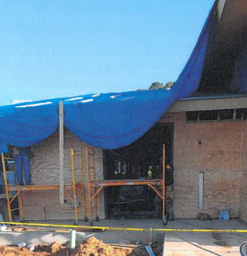
Appeal by SNB of Dillon
Claims for unresolved changes to plywood/insulation inversion
Structural drawings showed plywood sheathing attached directly to studs
But addendum showed ¾” foamboard insulation attached directly to studs with plywood installed on outside
SNB had to remove and reinstall and requested compensation
Claim granted
Lesson learned: this was an architect error, but it is obviously important for the plans and drawings to be consistent

Slide 10
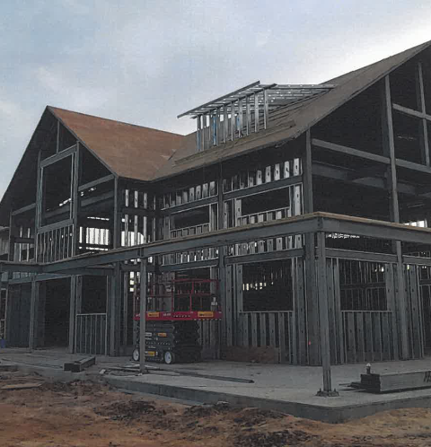
Appeal by SNB of Dillon
Claim for compensable delay for inwall bracing
SNB failed to install the bridging in the bearing and shear walls as required by the plans and specifications
Issues arose fixing the issue due to previously installed plumbing and electrical conduits, and because of holes and studs not aligning
SNB failed to proposed a solution and instead asked A/E; A/E was annoyed
SNB sought out another engineer for help, and placed issue with A/E
A/E rejected all solutions by other engineer
Claim granted in part—SNB mainly responsible but A/E responsible for part of delay at end
Lesson learned: Importance of cooperative relationship between A/E and contractor; issues with the relationship impacted the project

Slide 11
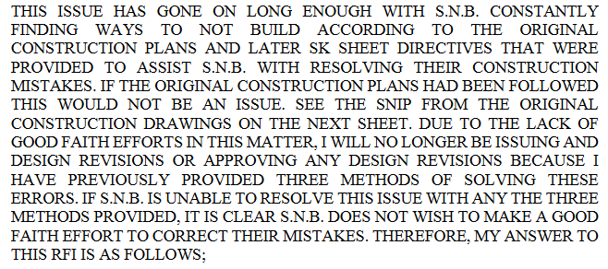
Appeal by SNB of Dillon
Architect’s response to RFI

Slide 12
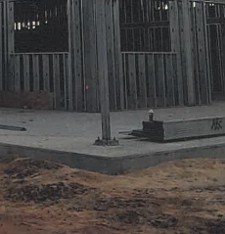
Appeal by SNB of Dillon
Claim for non-compensable delay for slab-on-grade
SNB’s subcontractor mixed additional water with concrete after it had already been mixed and delivered to make it easier to work
This resulted in failure of concrete to meet strength requirements
Claim denied
Lesson learned: don’t let your subs mix extra water in already mixed concrete

Slide 13
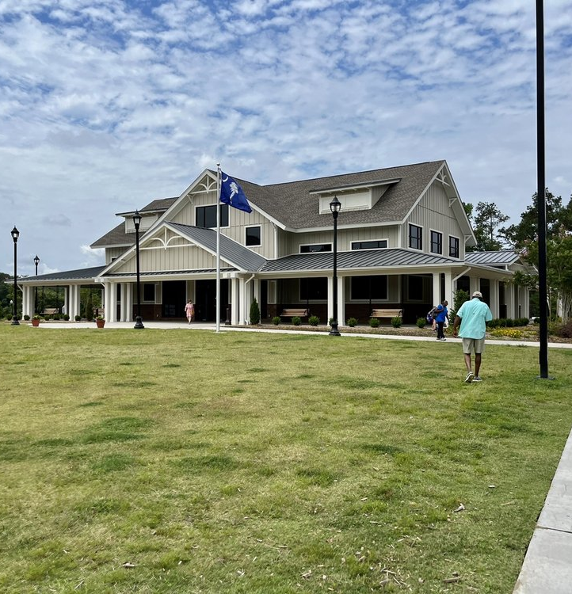
Appeal by SNB of Dillon
Claim for non-compensable delay for standing seam metal delays due to COVID-19
SNB failed to order the standing seam roof metal until 81 days after substantial completion date
The order was further delayed by COVID
Claim for 40-day extension granted
Lessons learned: Even if a contractor misses substantial completion date, a subsequent delay outside its control—such as a force majeure event—can still entitle the contract to relief for those days missed outside its control

Slide 14
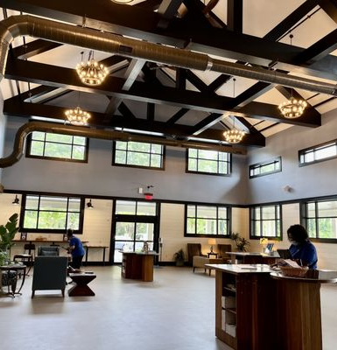
Appeal by SNB of Dillon
Summary
Denied all claims except—
Three change orders for $66,081
Compensable delays for $132,807
Refund of assessed liquidated damages for $87,000
TOTAL $285,888
Bulk of decision not challenged, but contractor moved for reconsideration of claim for statutory interest and some other fees and deductions; still pending

Slide 15
Protests

Slide 16
Selected Protests Granted
Agency improperly determined non-responsive –
Matter of Duke Commercial Construction
Duke acknowledged addendum 2 on bid form but not addendum 1
Other documents with bid indicated Duke acknowledged addendum 1
Should have given Duke opportunity to provide affidavit acknowledging receipt
Matter of MAR Construction
MAR failed to acknowledge addendum 4 and was determined non-responsive
Addendum 4, however, merely restated addendum 1, which was acknowledged
Addendum 3 merely changed deadline for receipt of bids
Should have determined it to be a minor informality

Slide 17
Selected Protests Granted
Agency improperly determined non-responsive (continued)–
Matter of Building Performance Group
Original bid form sought 36 HVAC units; addendum 1 reduced to 34 units
BFG acknowledged addendum 1 but used original bid form
BFG was low bidder despite using bid form for 36 units
Mistake on face of bid that should have been clarified or waived
Agency improperly determined responsive
Matter of Burriss Electric
Solicitation required bidders to submit bid bond with bid; bidder failed to provide any bond
Section 11-35-3030(1)(c) requires rejection unless bond is in wrong amount or improper rating
When required, failure to provide any bond renders bid non-responsive.

Slide 18
Selected Protests Denied
Denied for failing to prove evaluation was arbitrary, capricious, or contrary to law
Matter of Climate Control Systems of Greenwood
Pre-qualification under Section 11-35-3023
Contractor received a “harmful reference” and it was evaluated partly on this
Contractor complained it should have had a chance to address the reference, but nothing in Code requires this
Agency had right to rely on reference and it was not arbitrary, capricious, or contrary to law

Slide 19
Selected Protests Denied
Denied for failing to prove non-responsibility determination was arbitrary, capricious, or contrary to law
Matter of Timekey Enterprises
Lack of proper license will render bidder non-responsible
Section 40-11-340 allows sole contractor—licensed under 40-11-410(4) and (5)—to perform work outside classification if 50% or more of work, measured by total cost of construction, falls within classification or subclassification
A/E estimated only 44% of total cost of construction fell under contractor’s license
Agency entitled to rely on A/E estimate; this was not arbitrary or capricious.

Slide 20
Selected Protests Denied
Denied for failing to prove non-responsibility determination was arbitrary, capricious, or contrary to law (continued)
Matter of Bastion Group, LLC
Bidder lacked highway-bridges license but claimed it was performing enough percentage of project within classification
Agency determined work performed by bidder would not be a sufficient percentage
CPOC found agency had a rational basis.
Lesson learned: interpreting licensing laws is not easy. You do not have to be completely right, so long as your determination had a rational basis and was not arbitrary or capricious

Slide 21
Bonus John White Quote
“Determining who is properly licensed to bid a project is often unclear because the laws governing the licensing of contractors are not clearly written. The language and grammar used in those laws create confusion concerning their proper application to construction projects. Attorneys trained in statutory interpretation find divining the intent of the contractor’s licensing laws challenging. These same laws place on project owners and others without legal training the burden of properly interpreting them before considering a bid or making an award.”

Slide 22
Questions?

